Slide 1
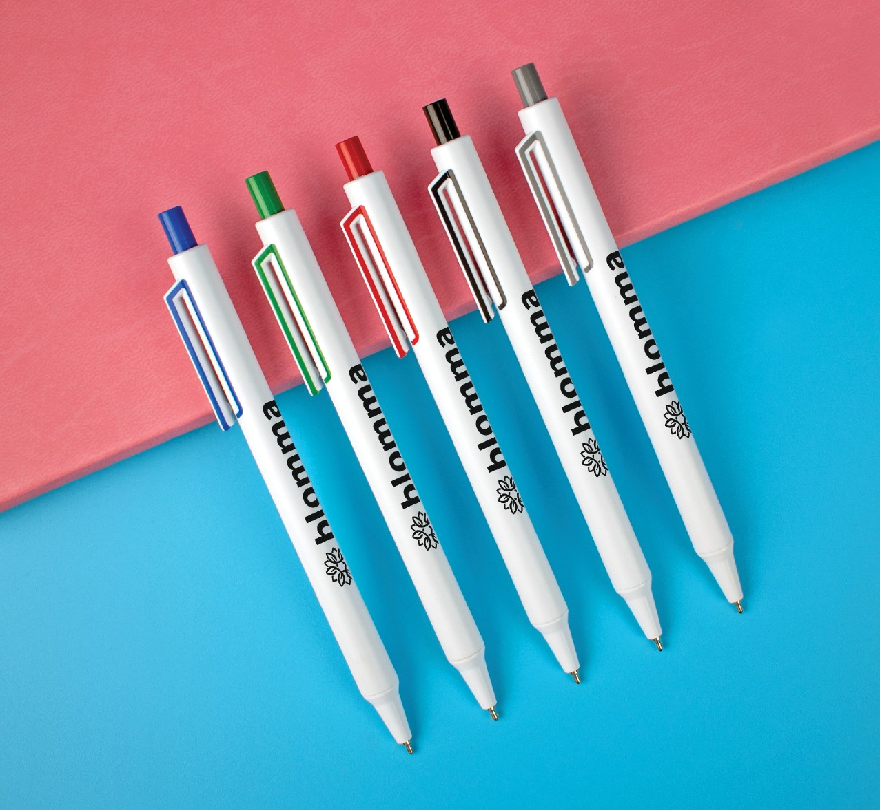
SPECTACLE
(Item No: 242)
It's all in the details. The Spectacle features sleek white barrels accented with a pop of color framing the clip and plunger. It features a generous imprint area, so your logo stands out from the crowd, and the black hybrid ink delivers effortless writing.
Full Color
Good through 12/31/2022. 1 Color silkscreen setup $15. Optional full color imprints available, additional charges and restrictions apply. Standard production is 7 business days. FOB MA. All pricing in USD and subject to change.

