Slide 1
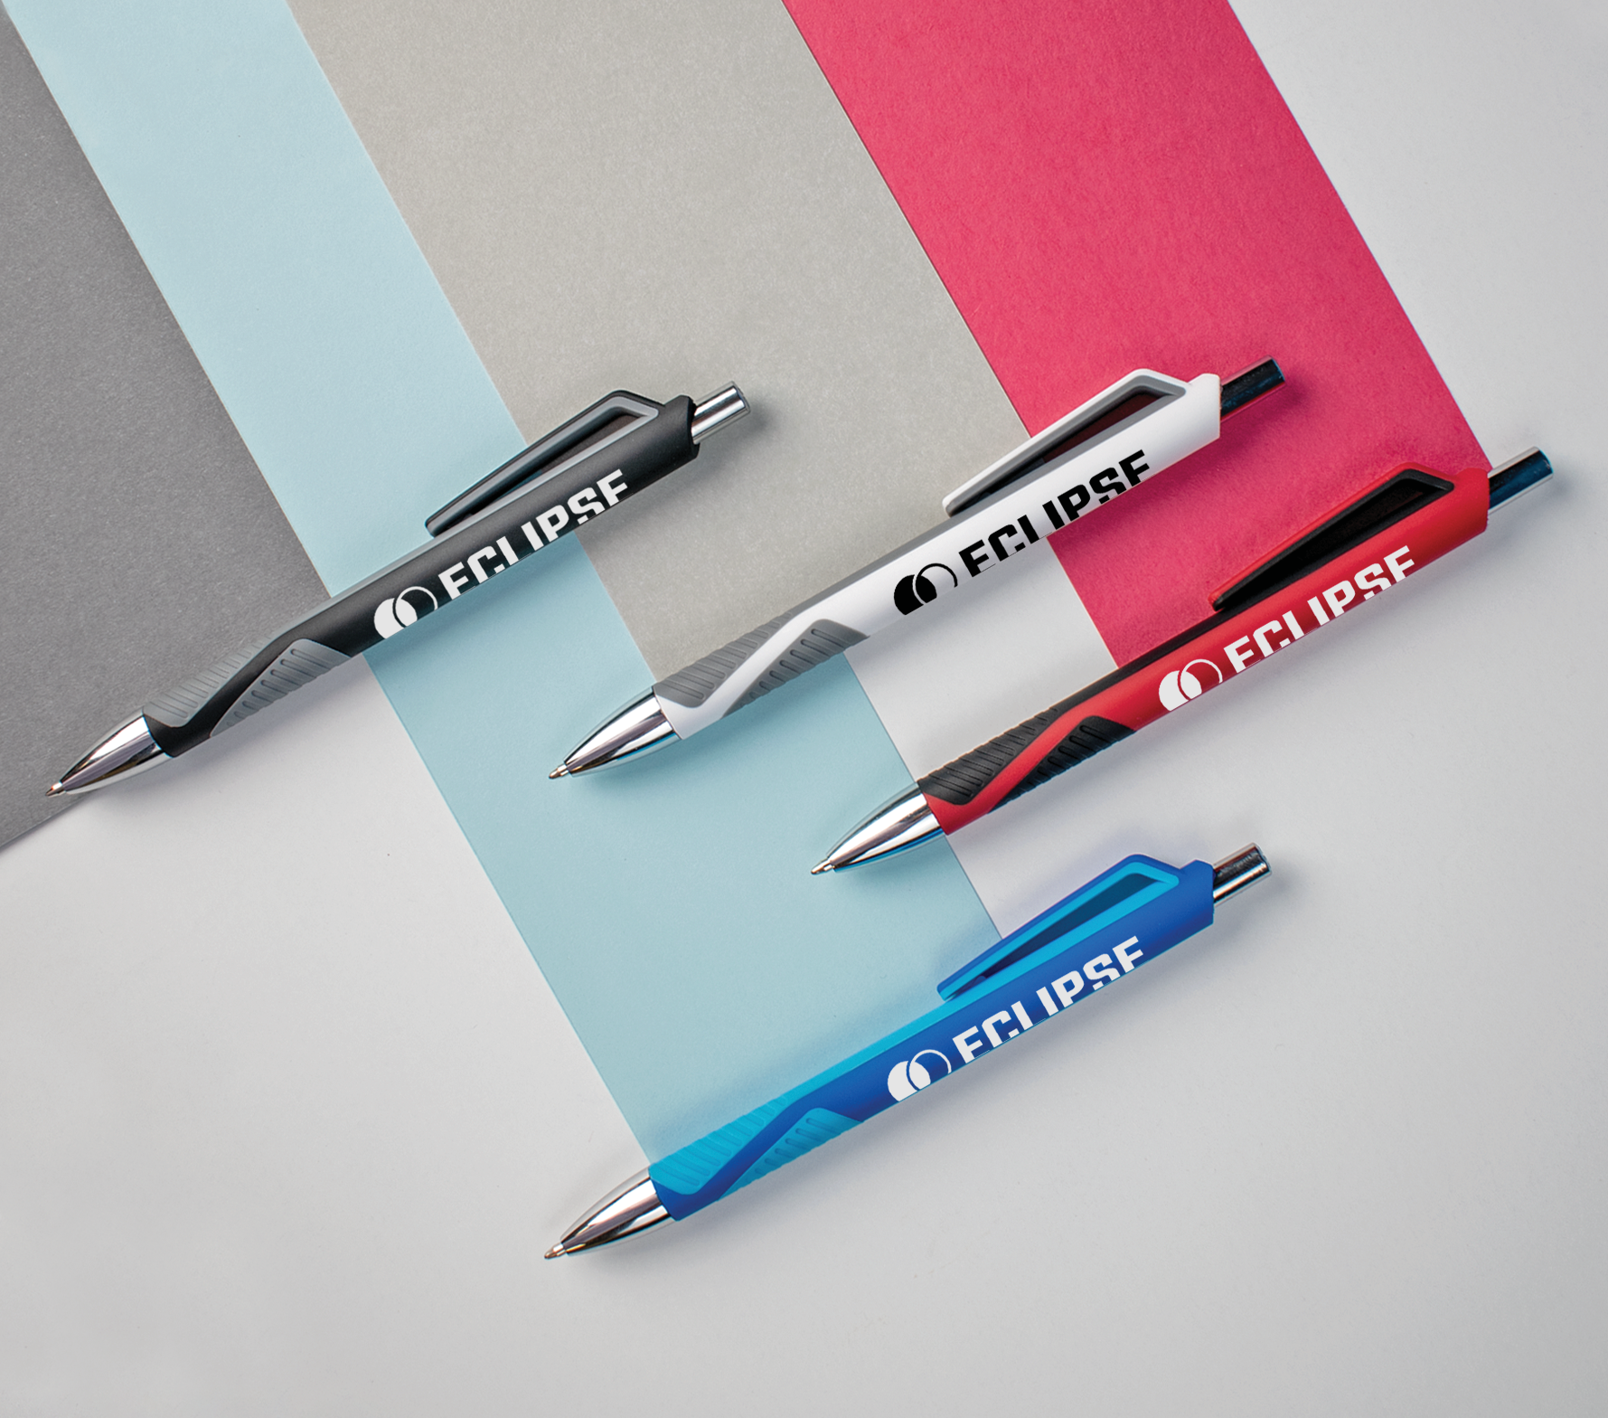
ZODIAC COMFORT
(Item No: 470)
Contrasting tones align for a promo pen that’s out of this world. The jumbo rubberized barrel features a ridged grip for the ultimate writing comfort, paired with black anti-fraud ink for max protection.
Full Color
Good through 12/31/2022. 1 Color silkscreen setup $15. Optional full color imprints available, additional charges and restrictions apply. Standard production is 7 business days. FOB MA. All pricing in USD and subject to change.

