Slide 1
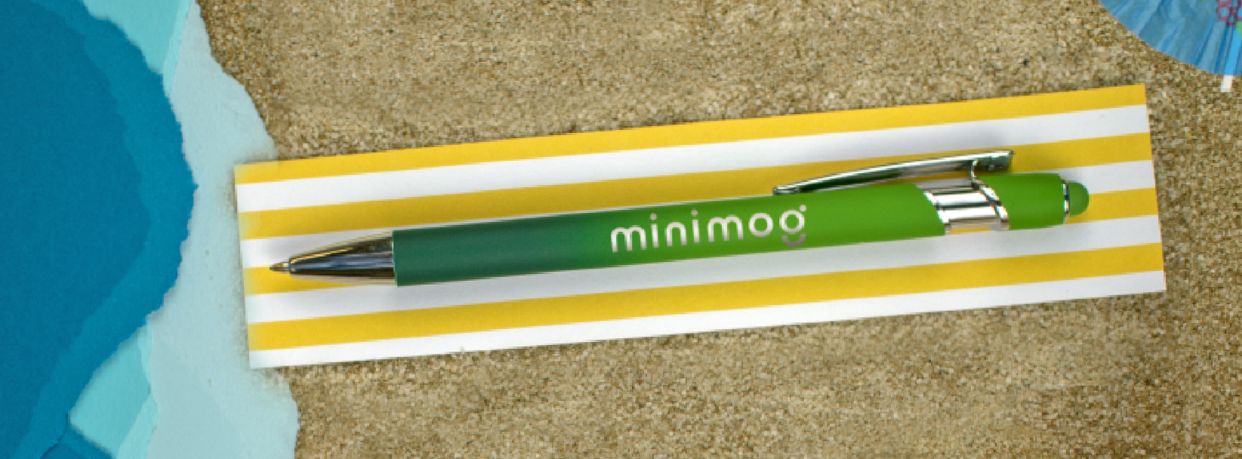
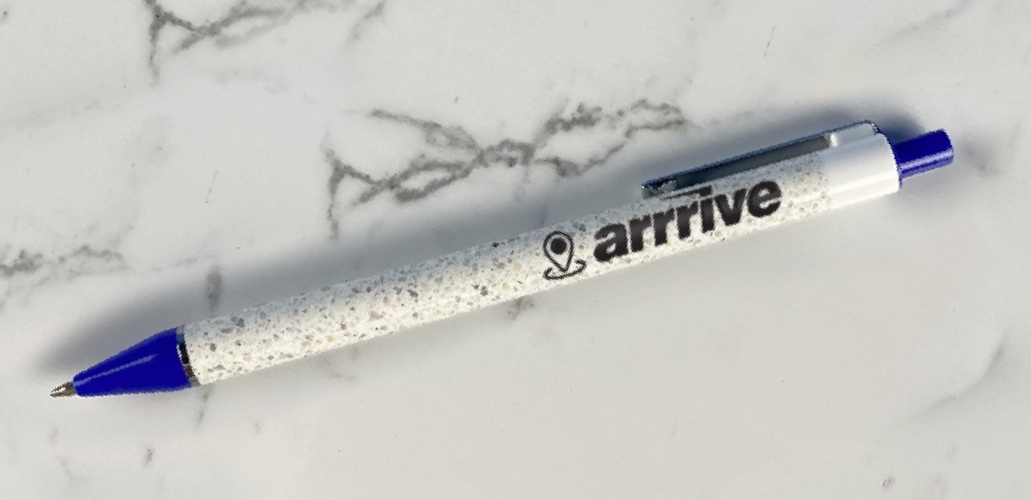
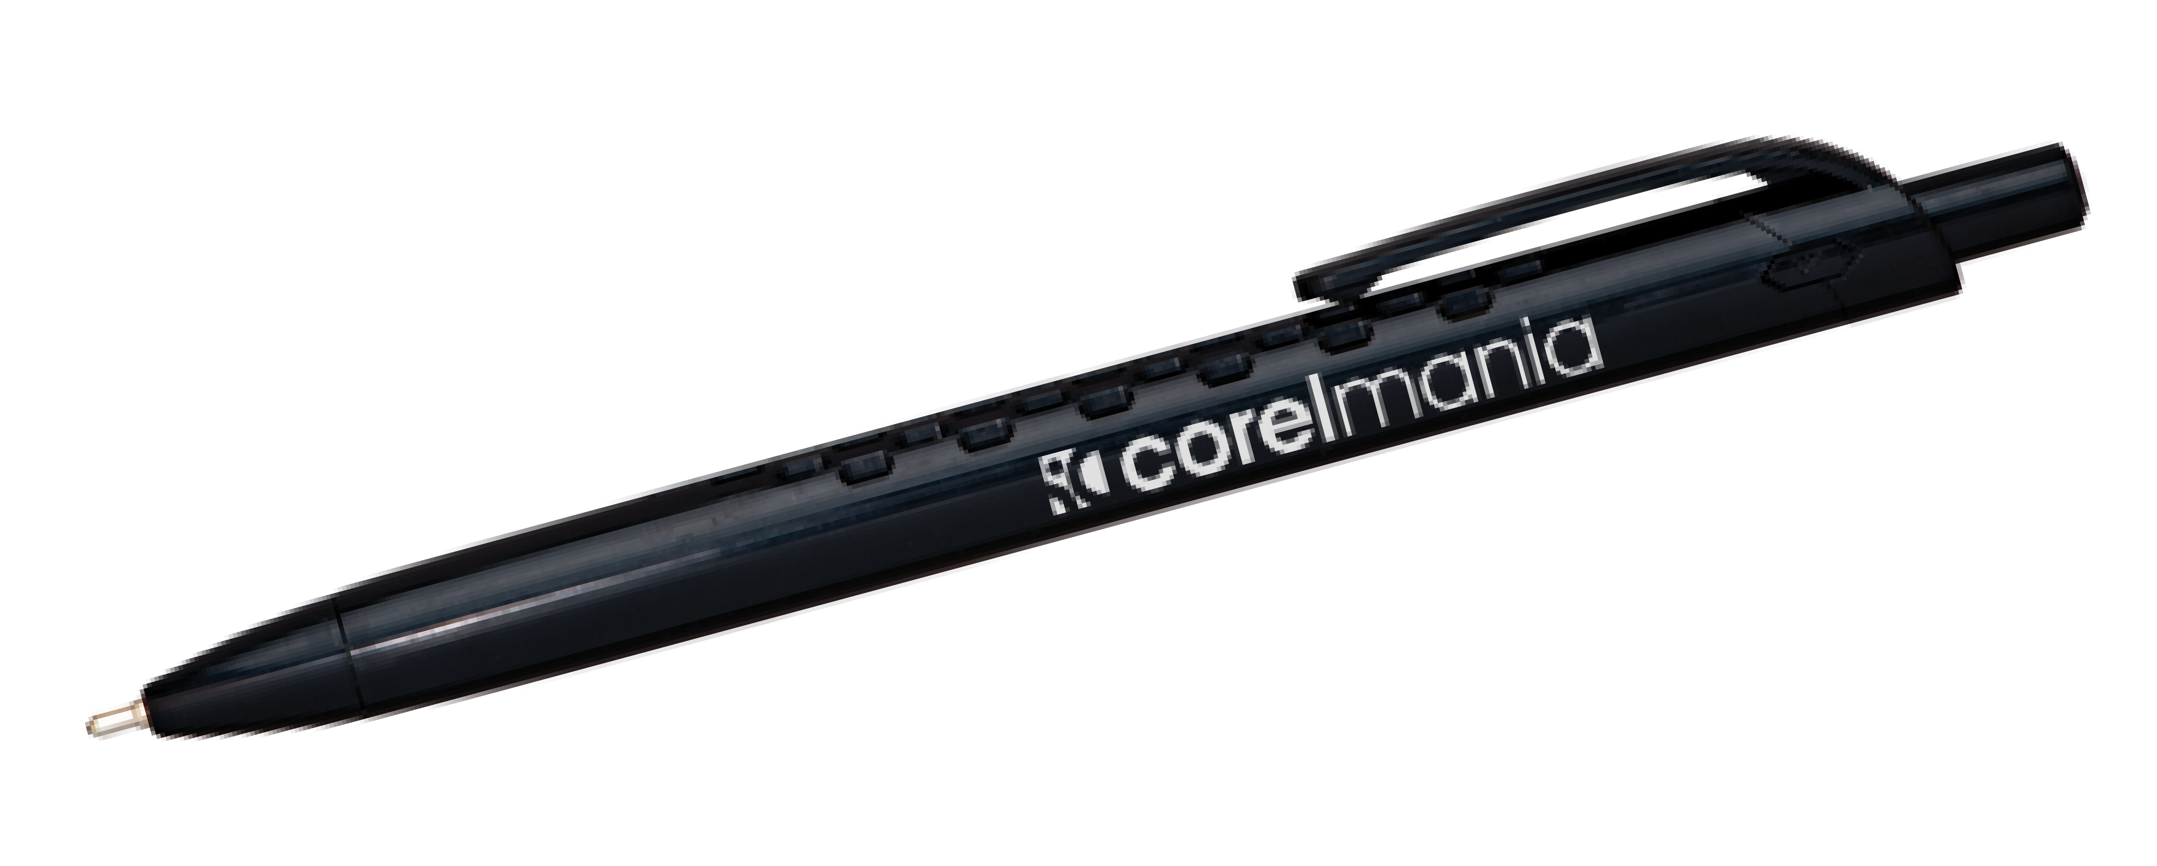
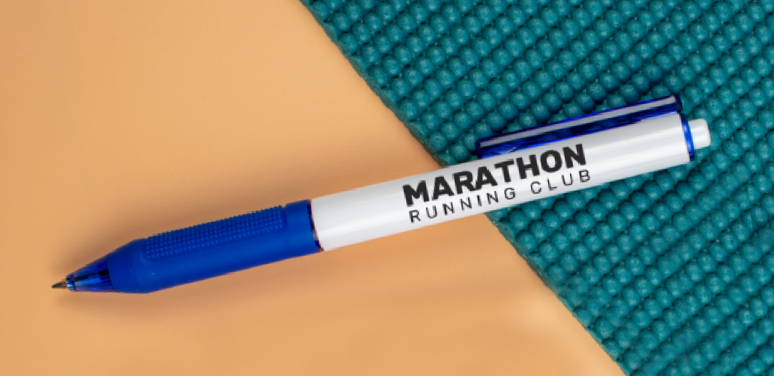
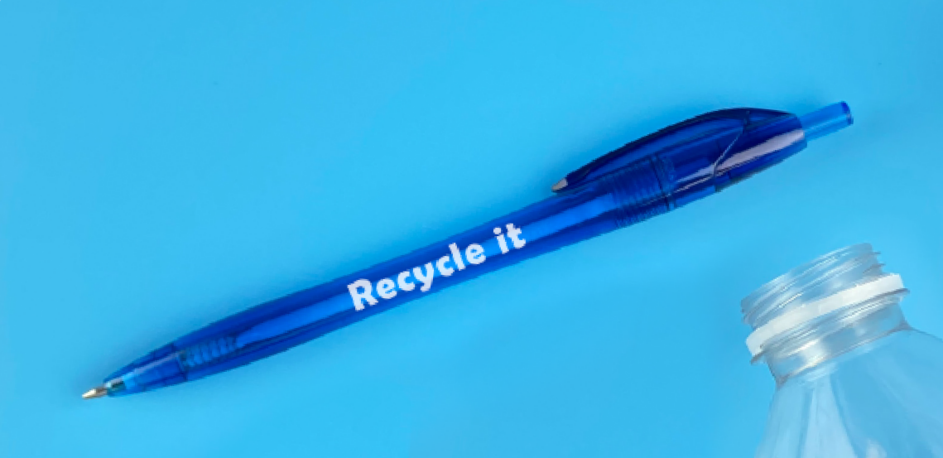
Here's a recap of what's
NEW & NOW!
Textari® Bali ^{Item: 703}
1
Enviro Item: 424
1
Terrazzo Item: 294
Vinyasa Grip ^{Item: 295}
1
Javalin® Revive ^{Item: 296}
Good through 12/31/2022. 1 Color silkscreen setup $15. Optional two and full color imprints available, additional charges and restrictions apply. FREE 24 hour rush service available, restrictions apply. Standard production is five business days. FOB MA. All pricing in USD and subject to change.

