Slide 1
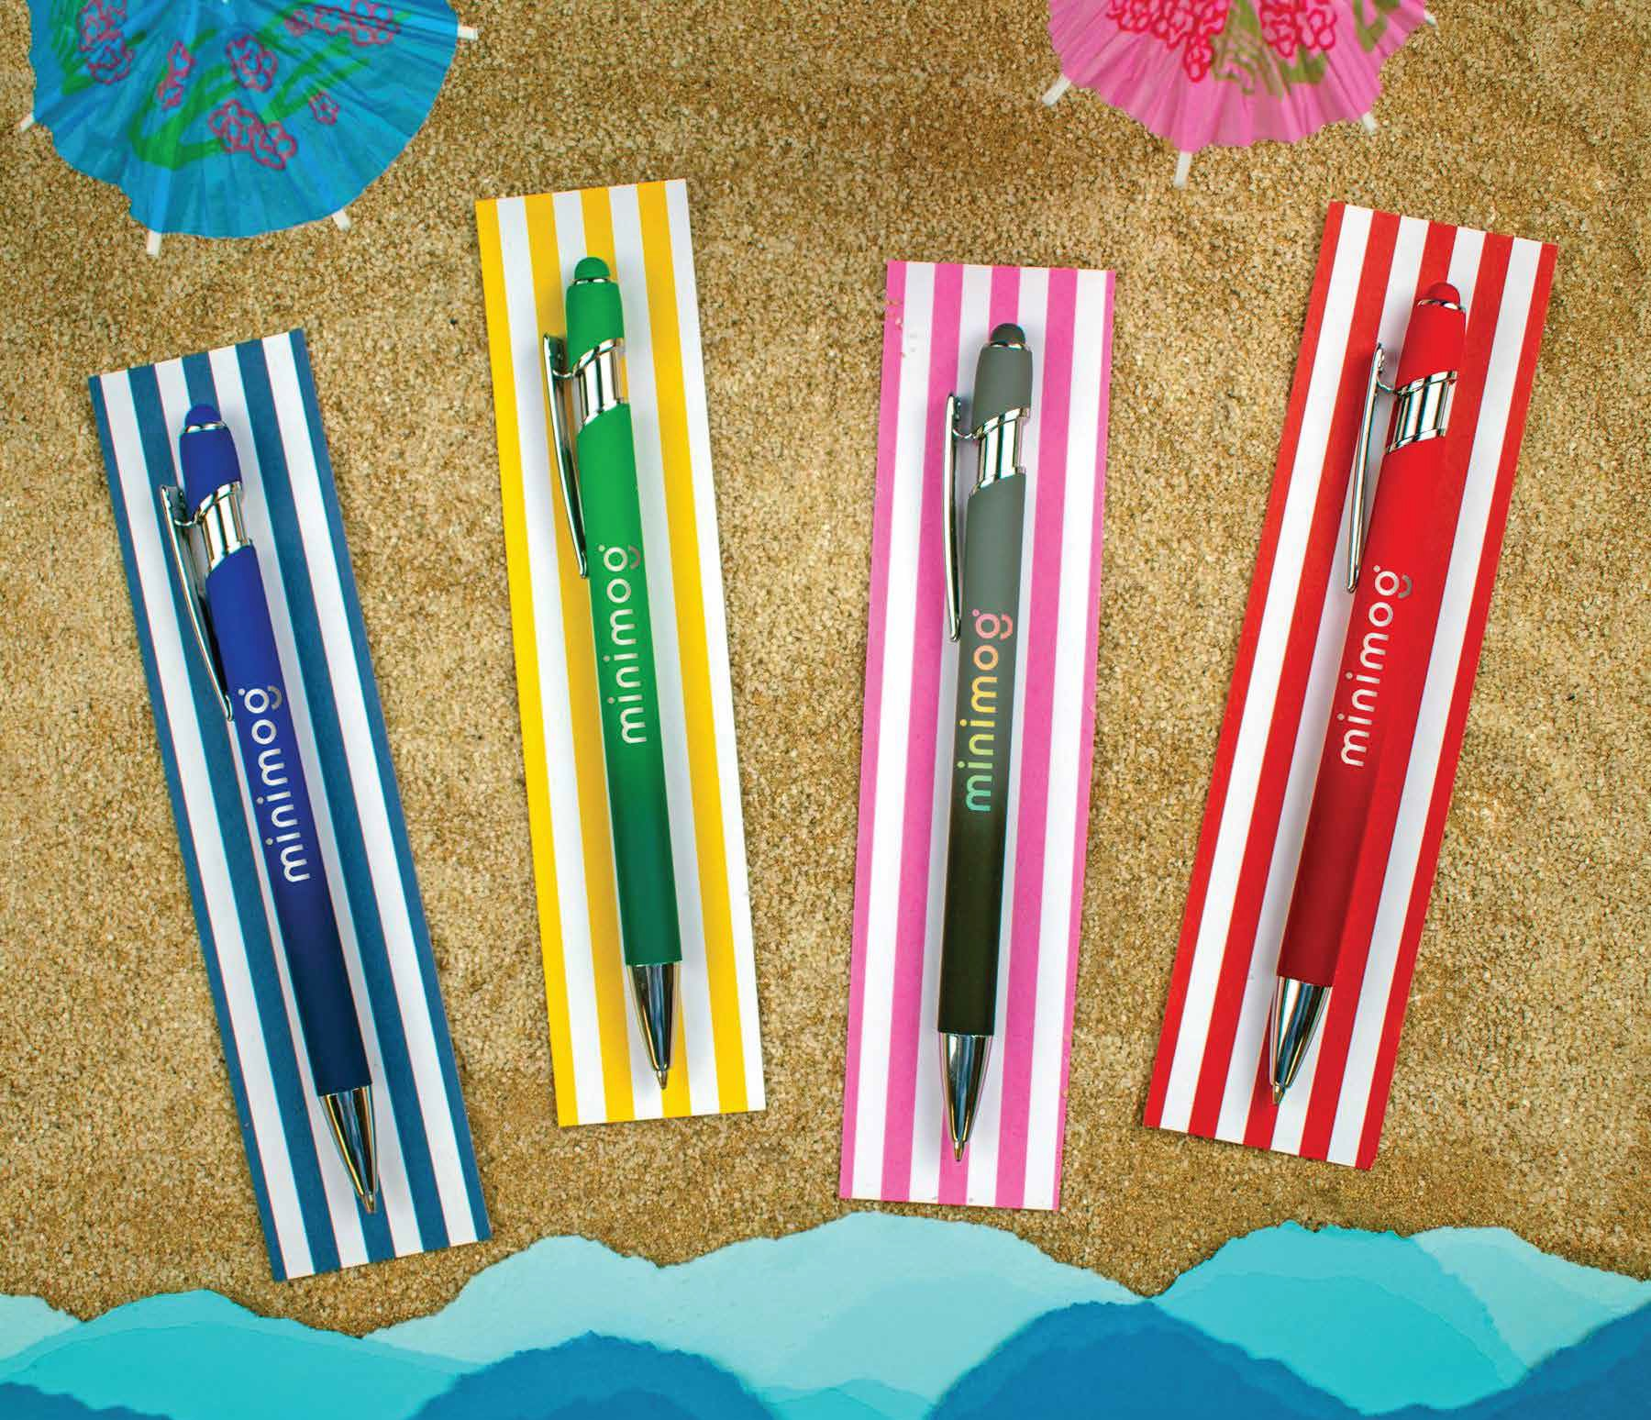
TEXTARI® BALI
(Item No: 703)
This executive metal stylus pen in a soft-touch finish makes a fashion statement in vivid ombre hues!
It features a handy stylus design for increased connectivity and smooth writing black anti-fraud ink for the best writing experience. Your message will stay top of mind with the generous imprint area.
Full Color
Stylus
Good through 12/31/2022. Laser setup $45. Optional full color imprints available, additional charges and restrictions apply. Standard production is five business days. FOB MA. All pricing in USD and subject to change.

