Slide 1
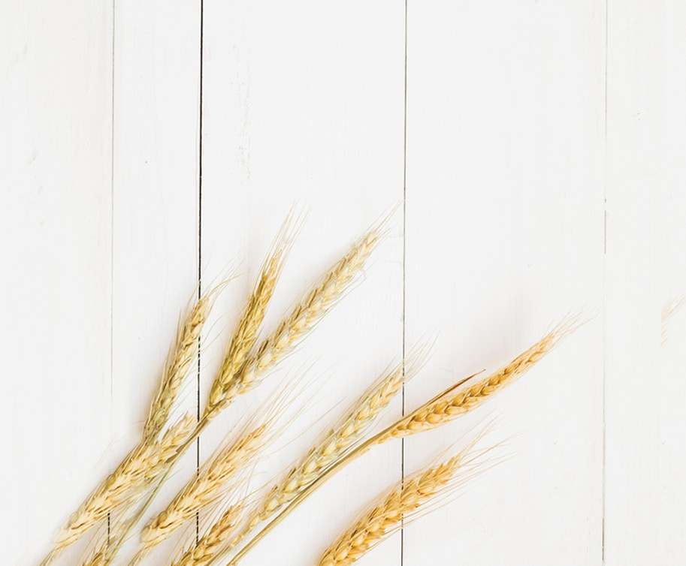
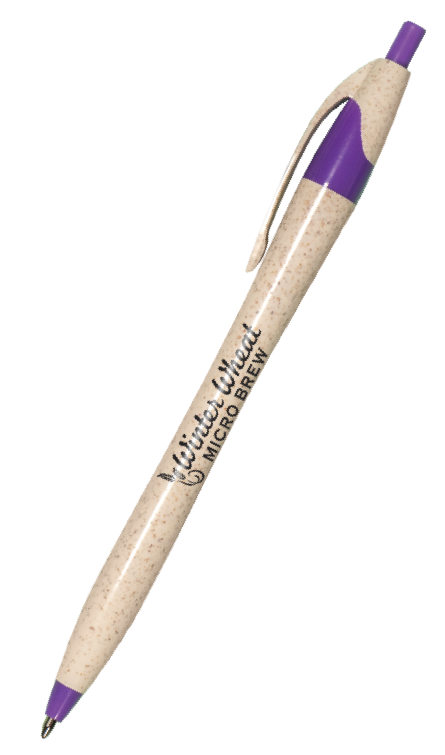
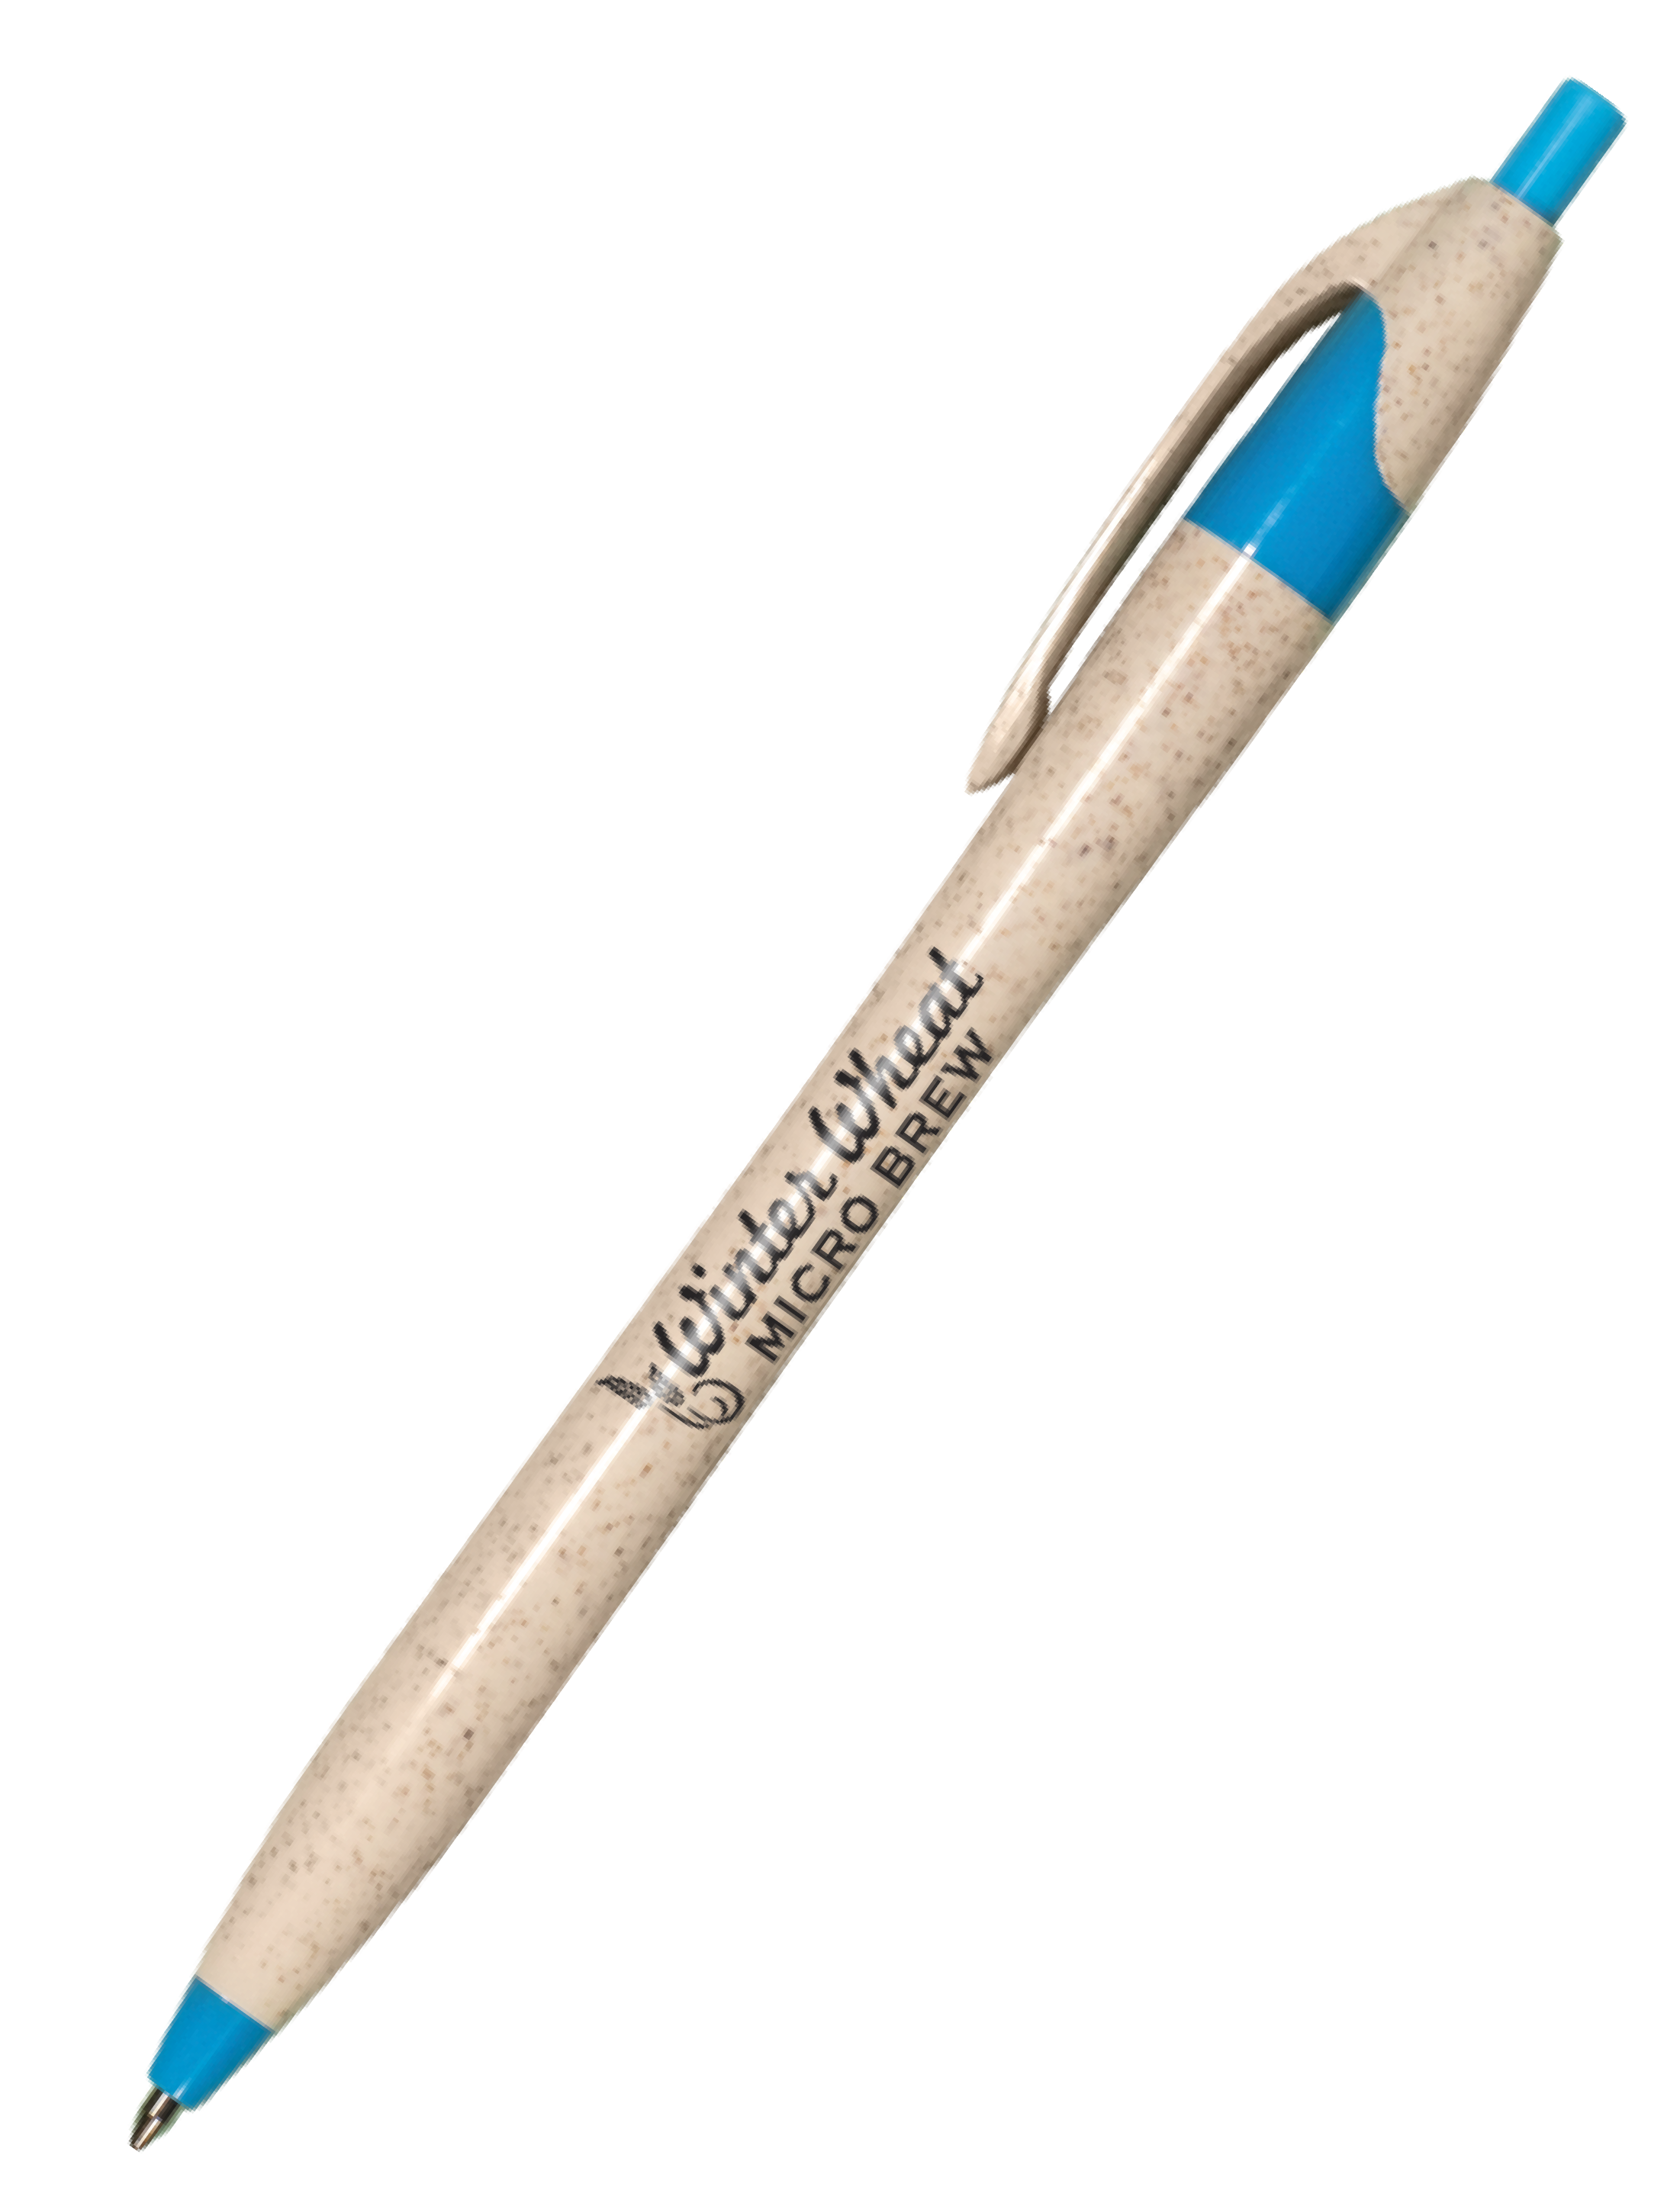
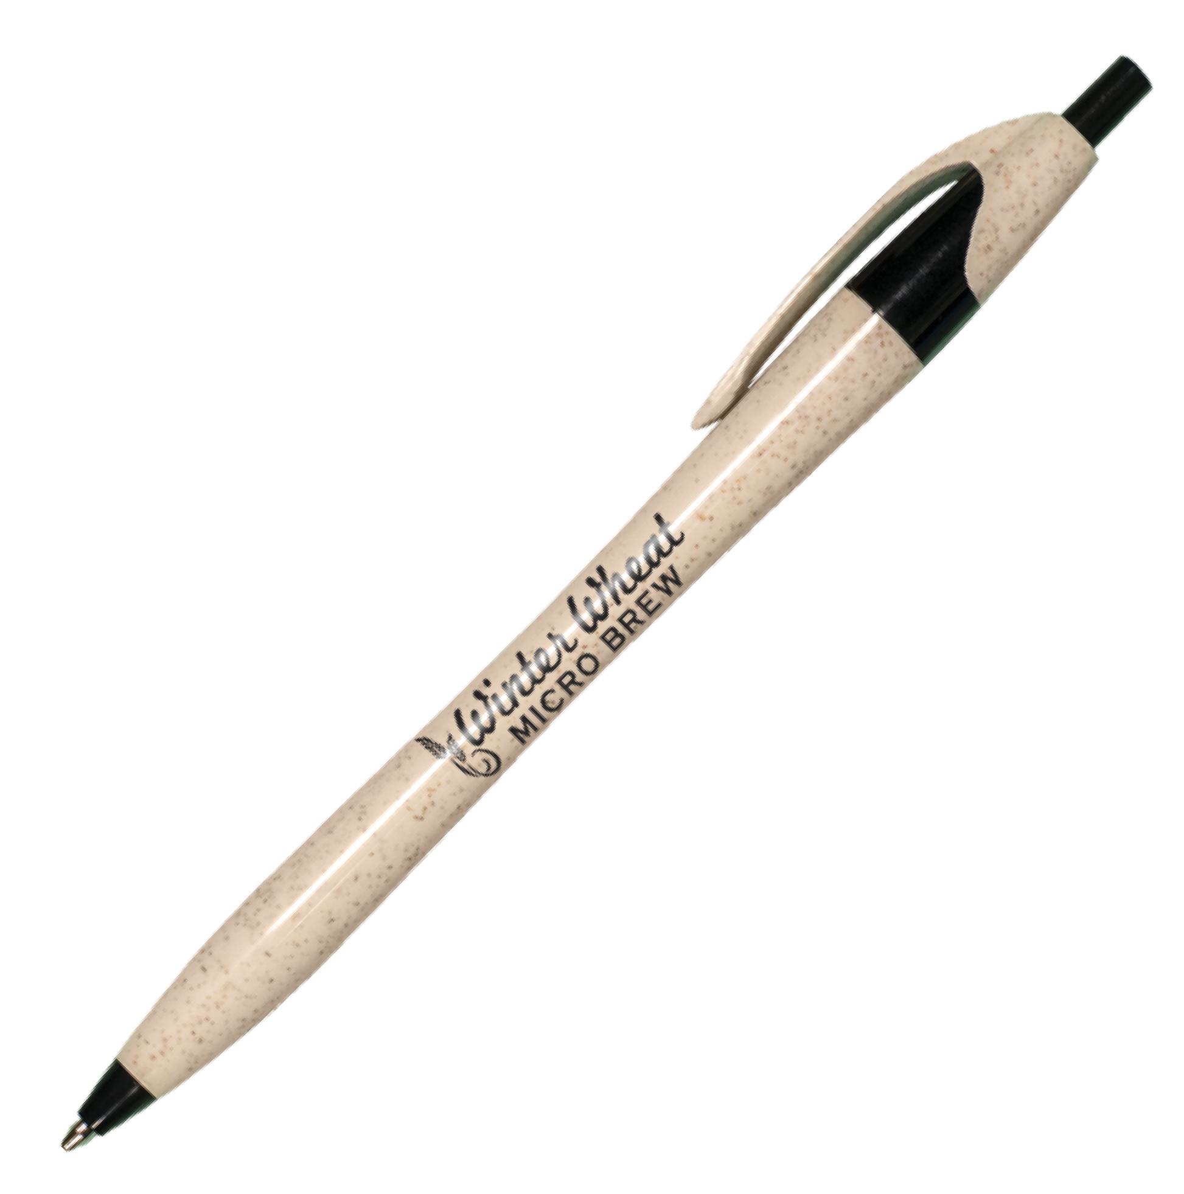
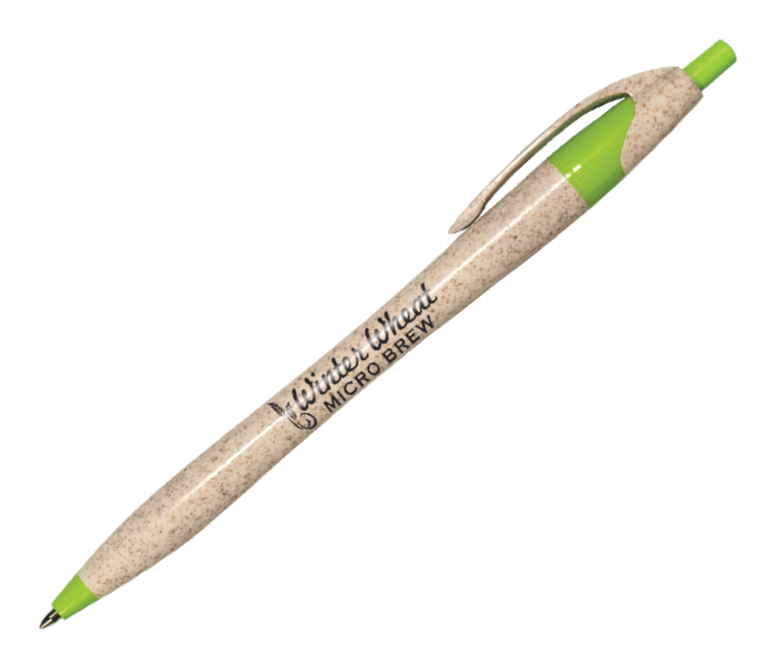
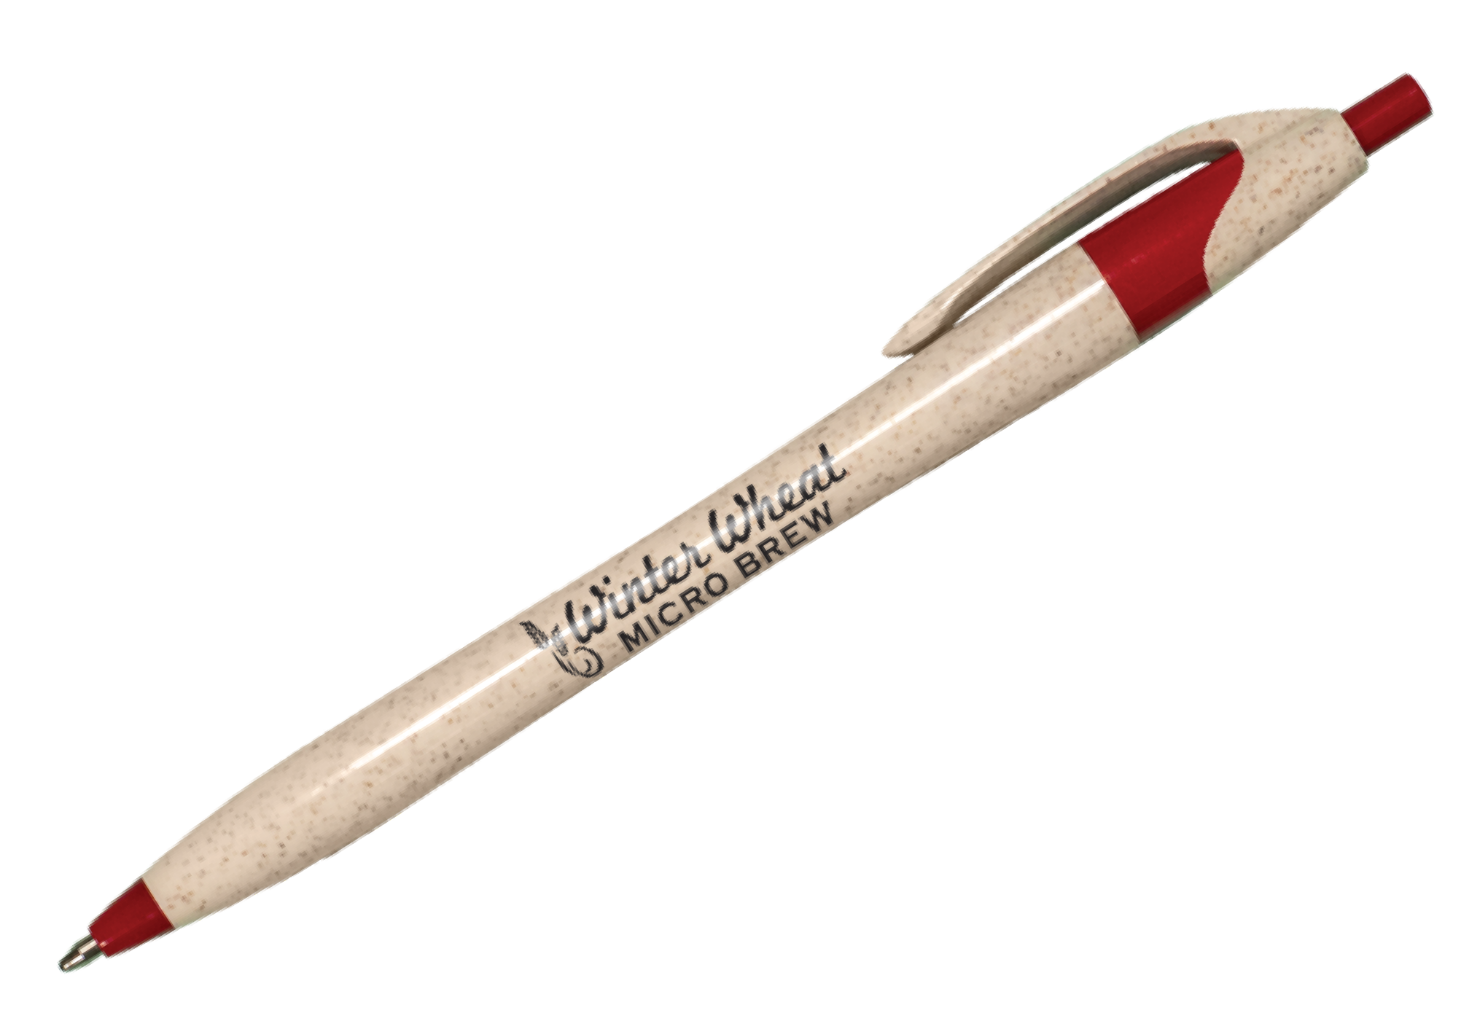
MADE FROM WHEAT
JAVALINA® ECO
(Item No: 311)
An eco-friendly Javalina made from a renewable and sustainable resource Composed of reclaimed wheat stalks and ABS plastic; resulting in less plastic used Speckled cream barrels accented with five clean and bright trim colors Ultrasmooth black writing ink
Good through 12/31/2022. 1 Color silkscreen setup $15. Optional two and full color imprints available, additional charges and restrictions apply. FREE 24 hour rush service available, restrictions apply. Standard production is five business days. FOB MA. All pricing in USD and subject to change. Complete product information available.

