Slide 1
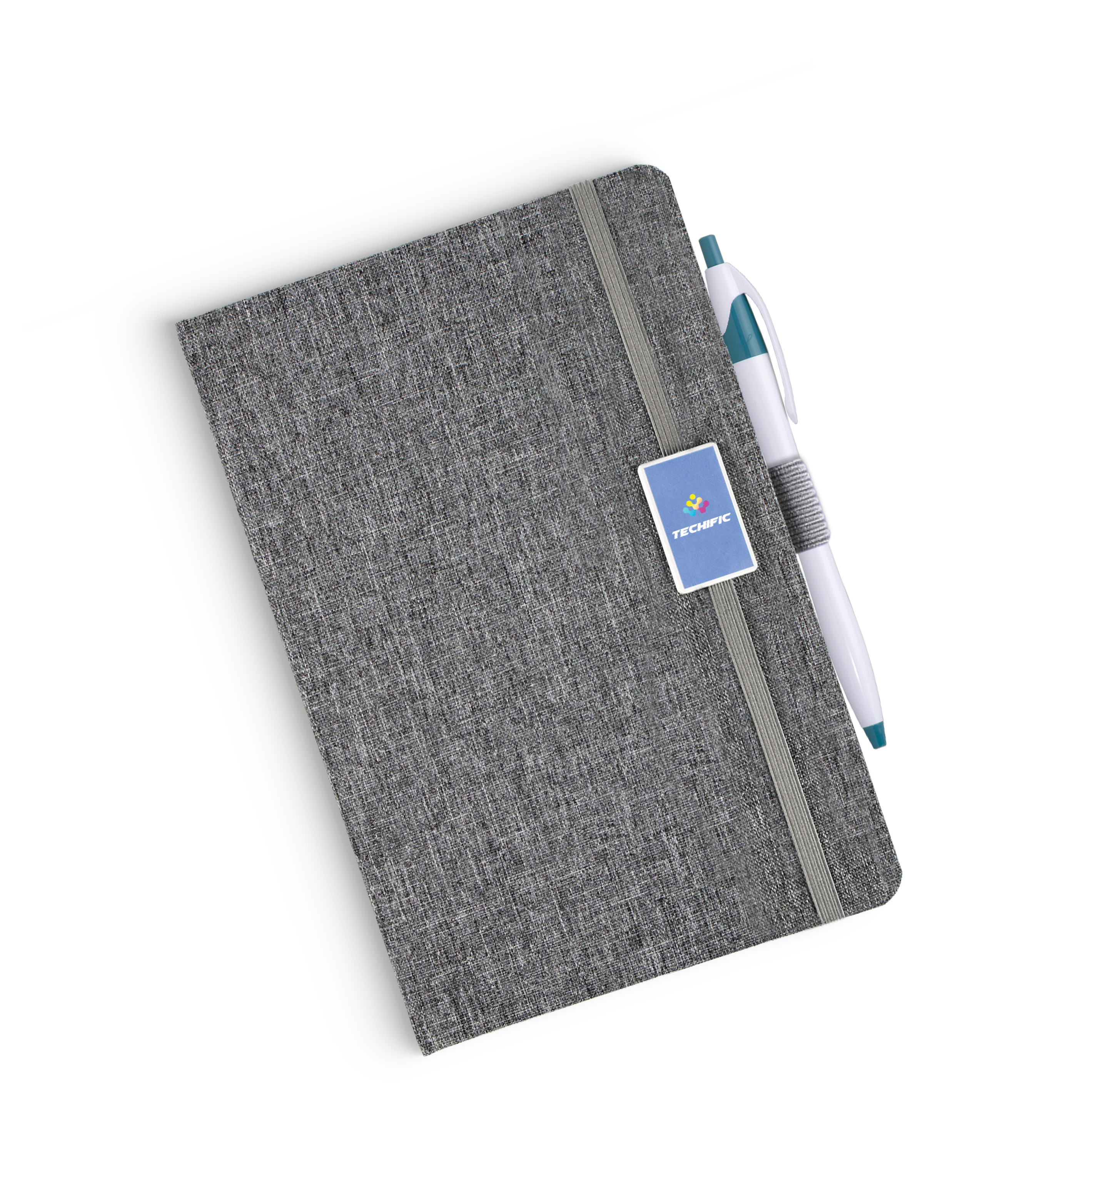
Turn an everyday task—note-taking, journaling, brainstorming, or doodling into a delightful experience with our new and improved Libretto!
New elastic band pen holder
LIBRETTO
(Item: NOTEBOOK)
This giftable journal features a full-color imprint on the toggle on the elastic band closure
A handy elastic band to keep your favorite pen in place
Fashionable tweed cover and 70g/㎡ weight stock for high-end appeal
Versatile dot grid paper for a variety of writing uses
Pen sold separately.
Good through 12/31/2021. Full color imprint setup on toggle $45. Standard production is five business days. FOB MA. All pricing in USD and subject to change. Complete product information available.

