Slide 1
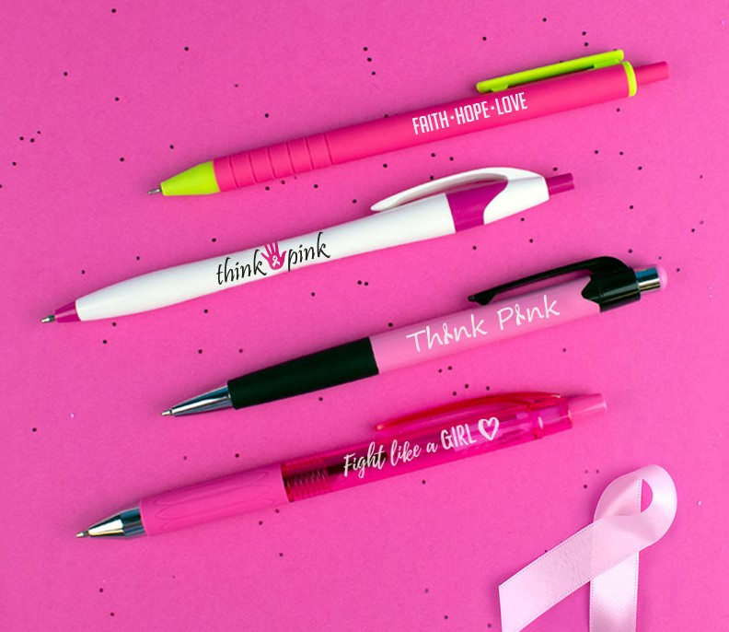
A
B
C
D
BREAST CANCER AWARENESS
MONTH IS IN OCTOBER!
Here are some pink pens to join the cause!
A. Sorbeta Comfort
Item: 262
B. Javalina® Color Write
Item: 310
C. Mardi Gras® Night
Item: 413
D. Frolico
Item: 425
Good through 12/31/2021. 1 Color silkscreen setup $15. Optional full color imprints available, additional charges and restrictions apply. Standard production is five business days. FOB MA. All pricing in USD and subject to change. Complete product information available.

