Slide 1
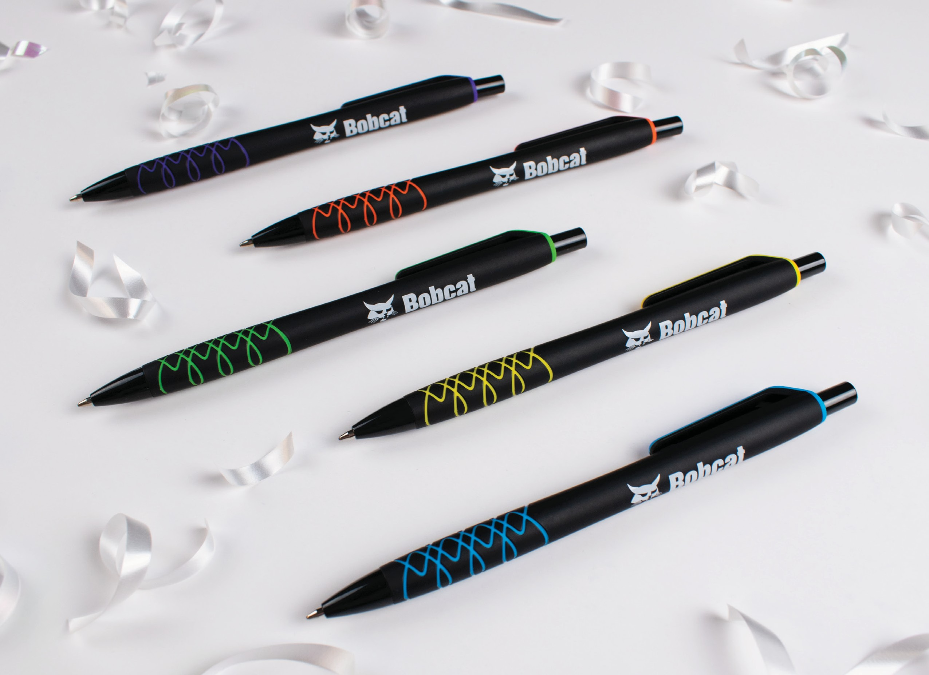
NEW
SPIRALINA COMFORT NIGHT
(Item No: 452)
Black barrels with vivid brights and a spiral accent Rubberized for a comfortable grip no matter where you hold Ergonomic hourglass shape for writing comfort
Smooth writing black ink
Good through 12/31/2021. 1 Color silkscreen setup $15. Optional full color imprints available, additional charges and restrictions apply. Standard production is five business days. FOB MA. All pricing in USD and subject to change.
Complete product information available.

