Slide 1
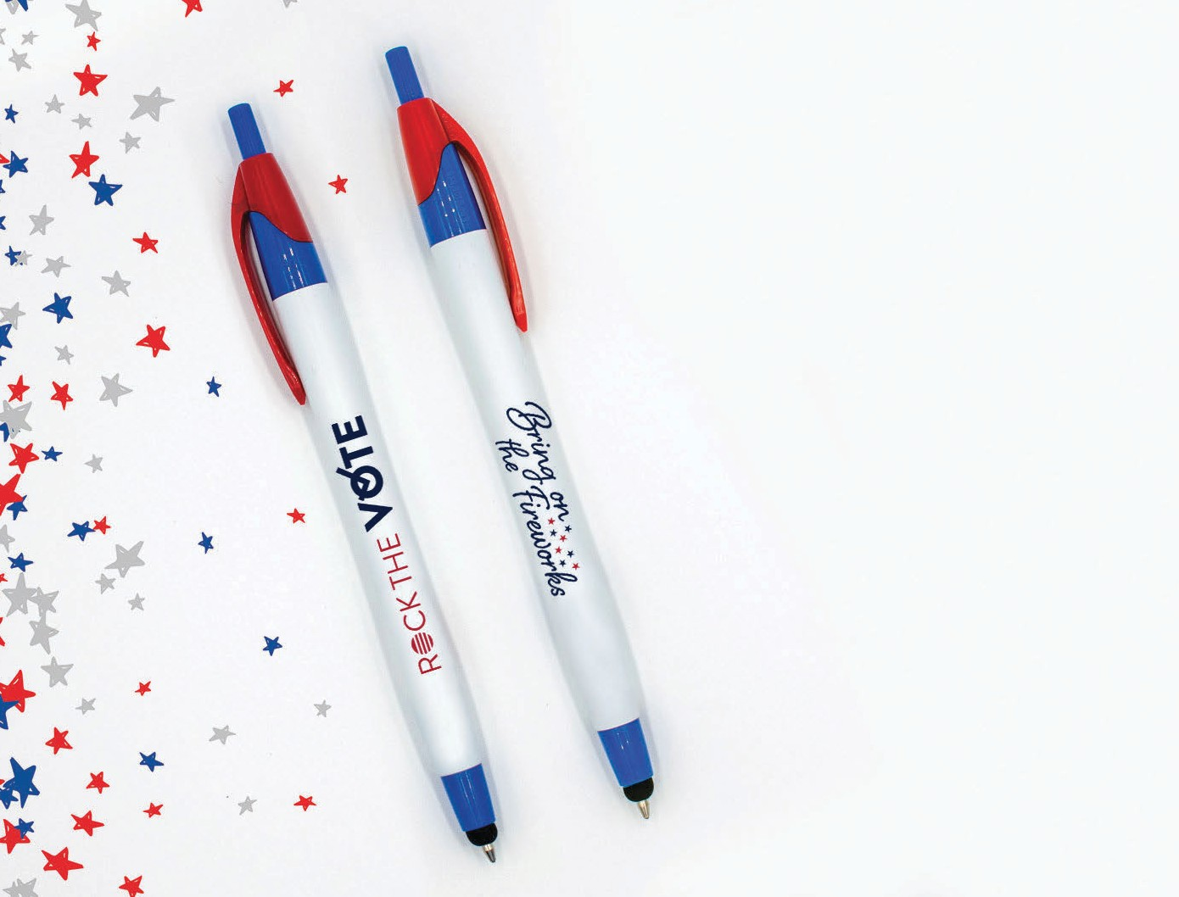
NEW
Javalina® Classic Stylus
(Item No: 332) US Pat. D709,949; 8,847,930 & 9,092,077
The multifunction Javalina® features a handy stylus tip with a white barrel and classic color trims to choose from. Paired with our guaranteed ultra-smooth writing cartridge in black ink for writing perfection!
Please note, the Patriotic color pen with red and blue trim comes with black ink only.
Good through 12/31/2021. 1 Color silkscreen setup $15. FREE 24 Hour Rush Service available, restrictions apply. Optional 2 color imprints available, additional charges and restrictions apply. Standard production is five business days. FOB MA. All pricing in USD and subject to change. Complete product information available.

