Slide 1
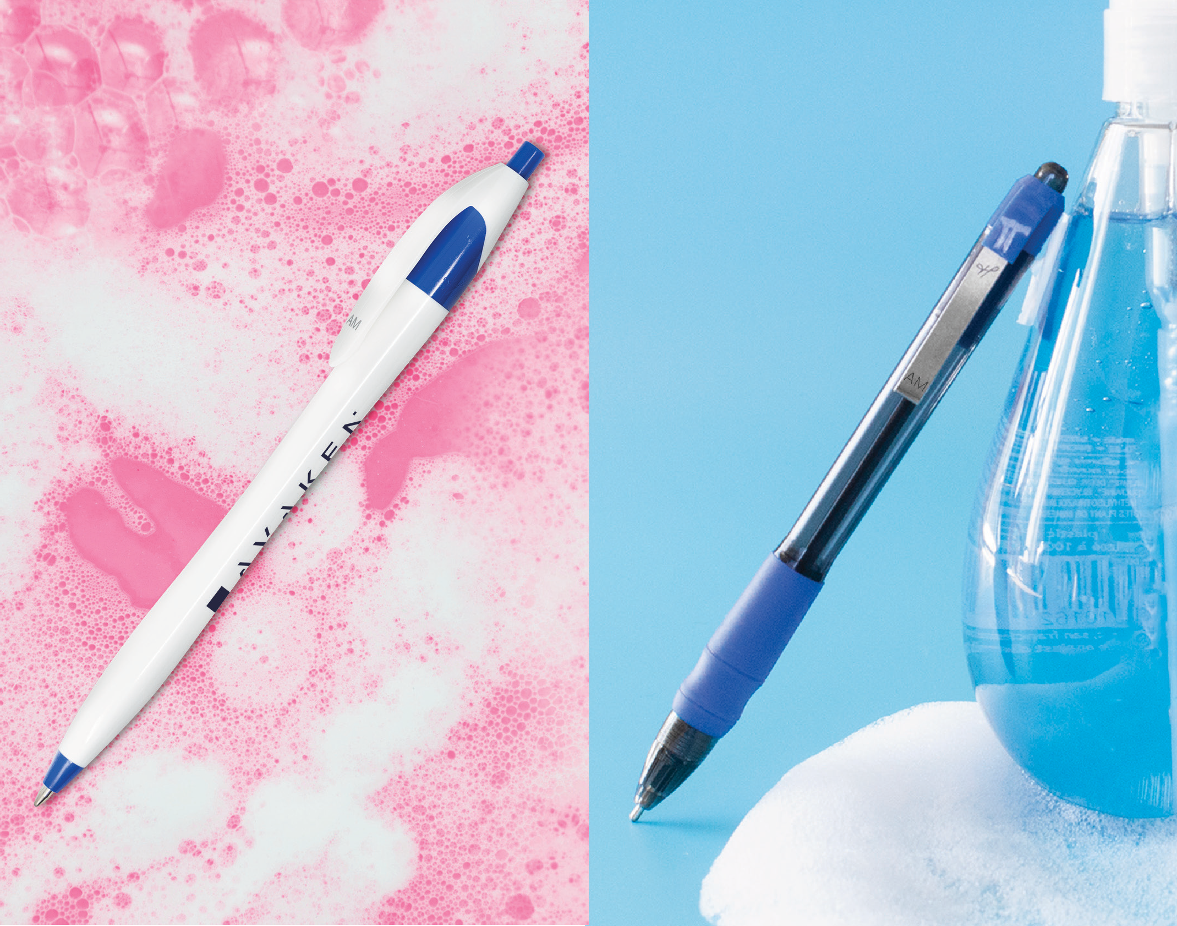
A
B
BACK TO SCHOOL WITH WRITING PEACE OF MIND!
A. Javalina® Pure Classic
Item: 299
B. MaxGlide® Pure
Item: 582
Good through 12/31/2021. 1 Color silkscreen setup $15. Optional two and full color imprints available, additional charges and restrictions apply. FREE 24 hour rush service available, restrictions apply. Standard production is five business days. FOB MA. All pricing in USD and subject to change. Complete product information available.

