Slide 1
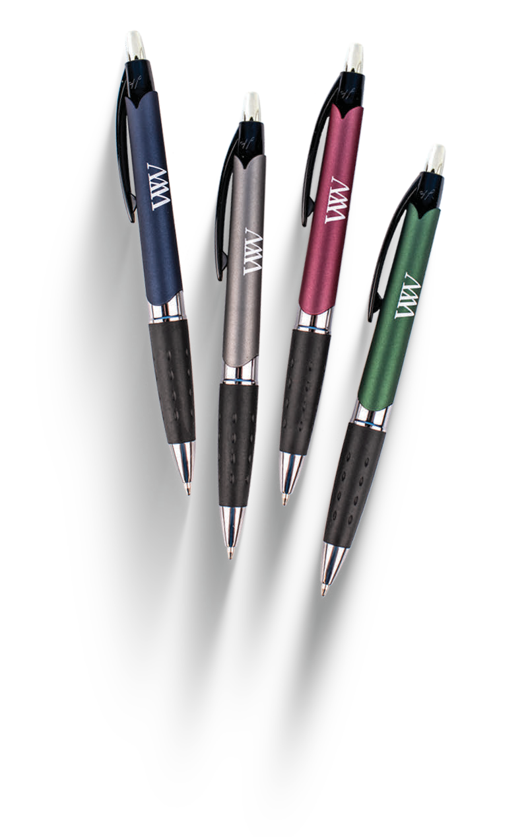
NEW
CUBANO COMFORT
(Item No: 427)
Jumbo barrel with a shining chrome cigar band trim
Deep corporate colors with a soft metallic finish
Dimpled black rubber grip provides writing comfort
Good through 12/31/2021. 1 Color silkscreen setup $15. Optional full color imprints available, additional charges and restrictions apply. Standard production is five business days. FOB MA. All pricing in USD and subject to change. Complete product information available.

