Slide 1
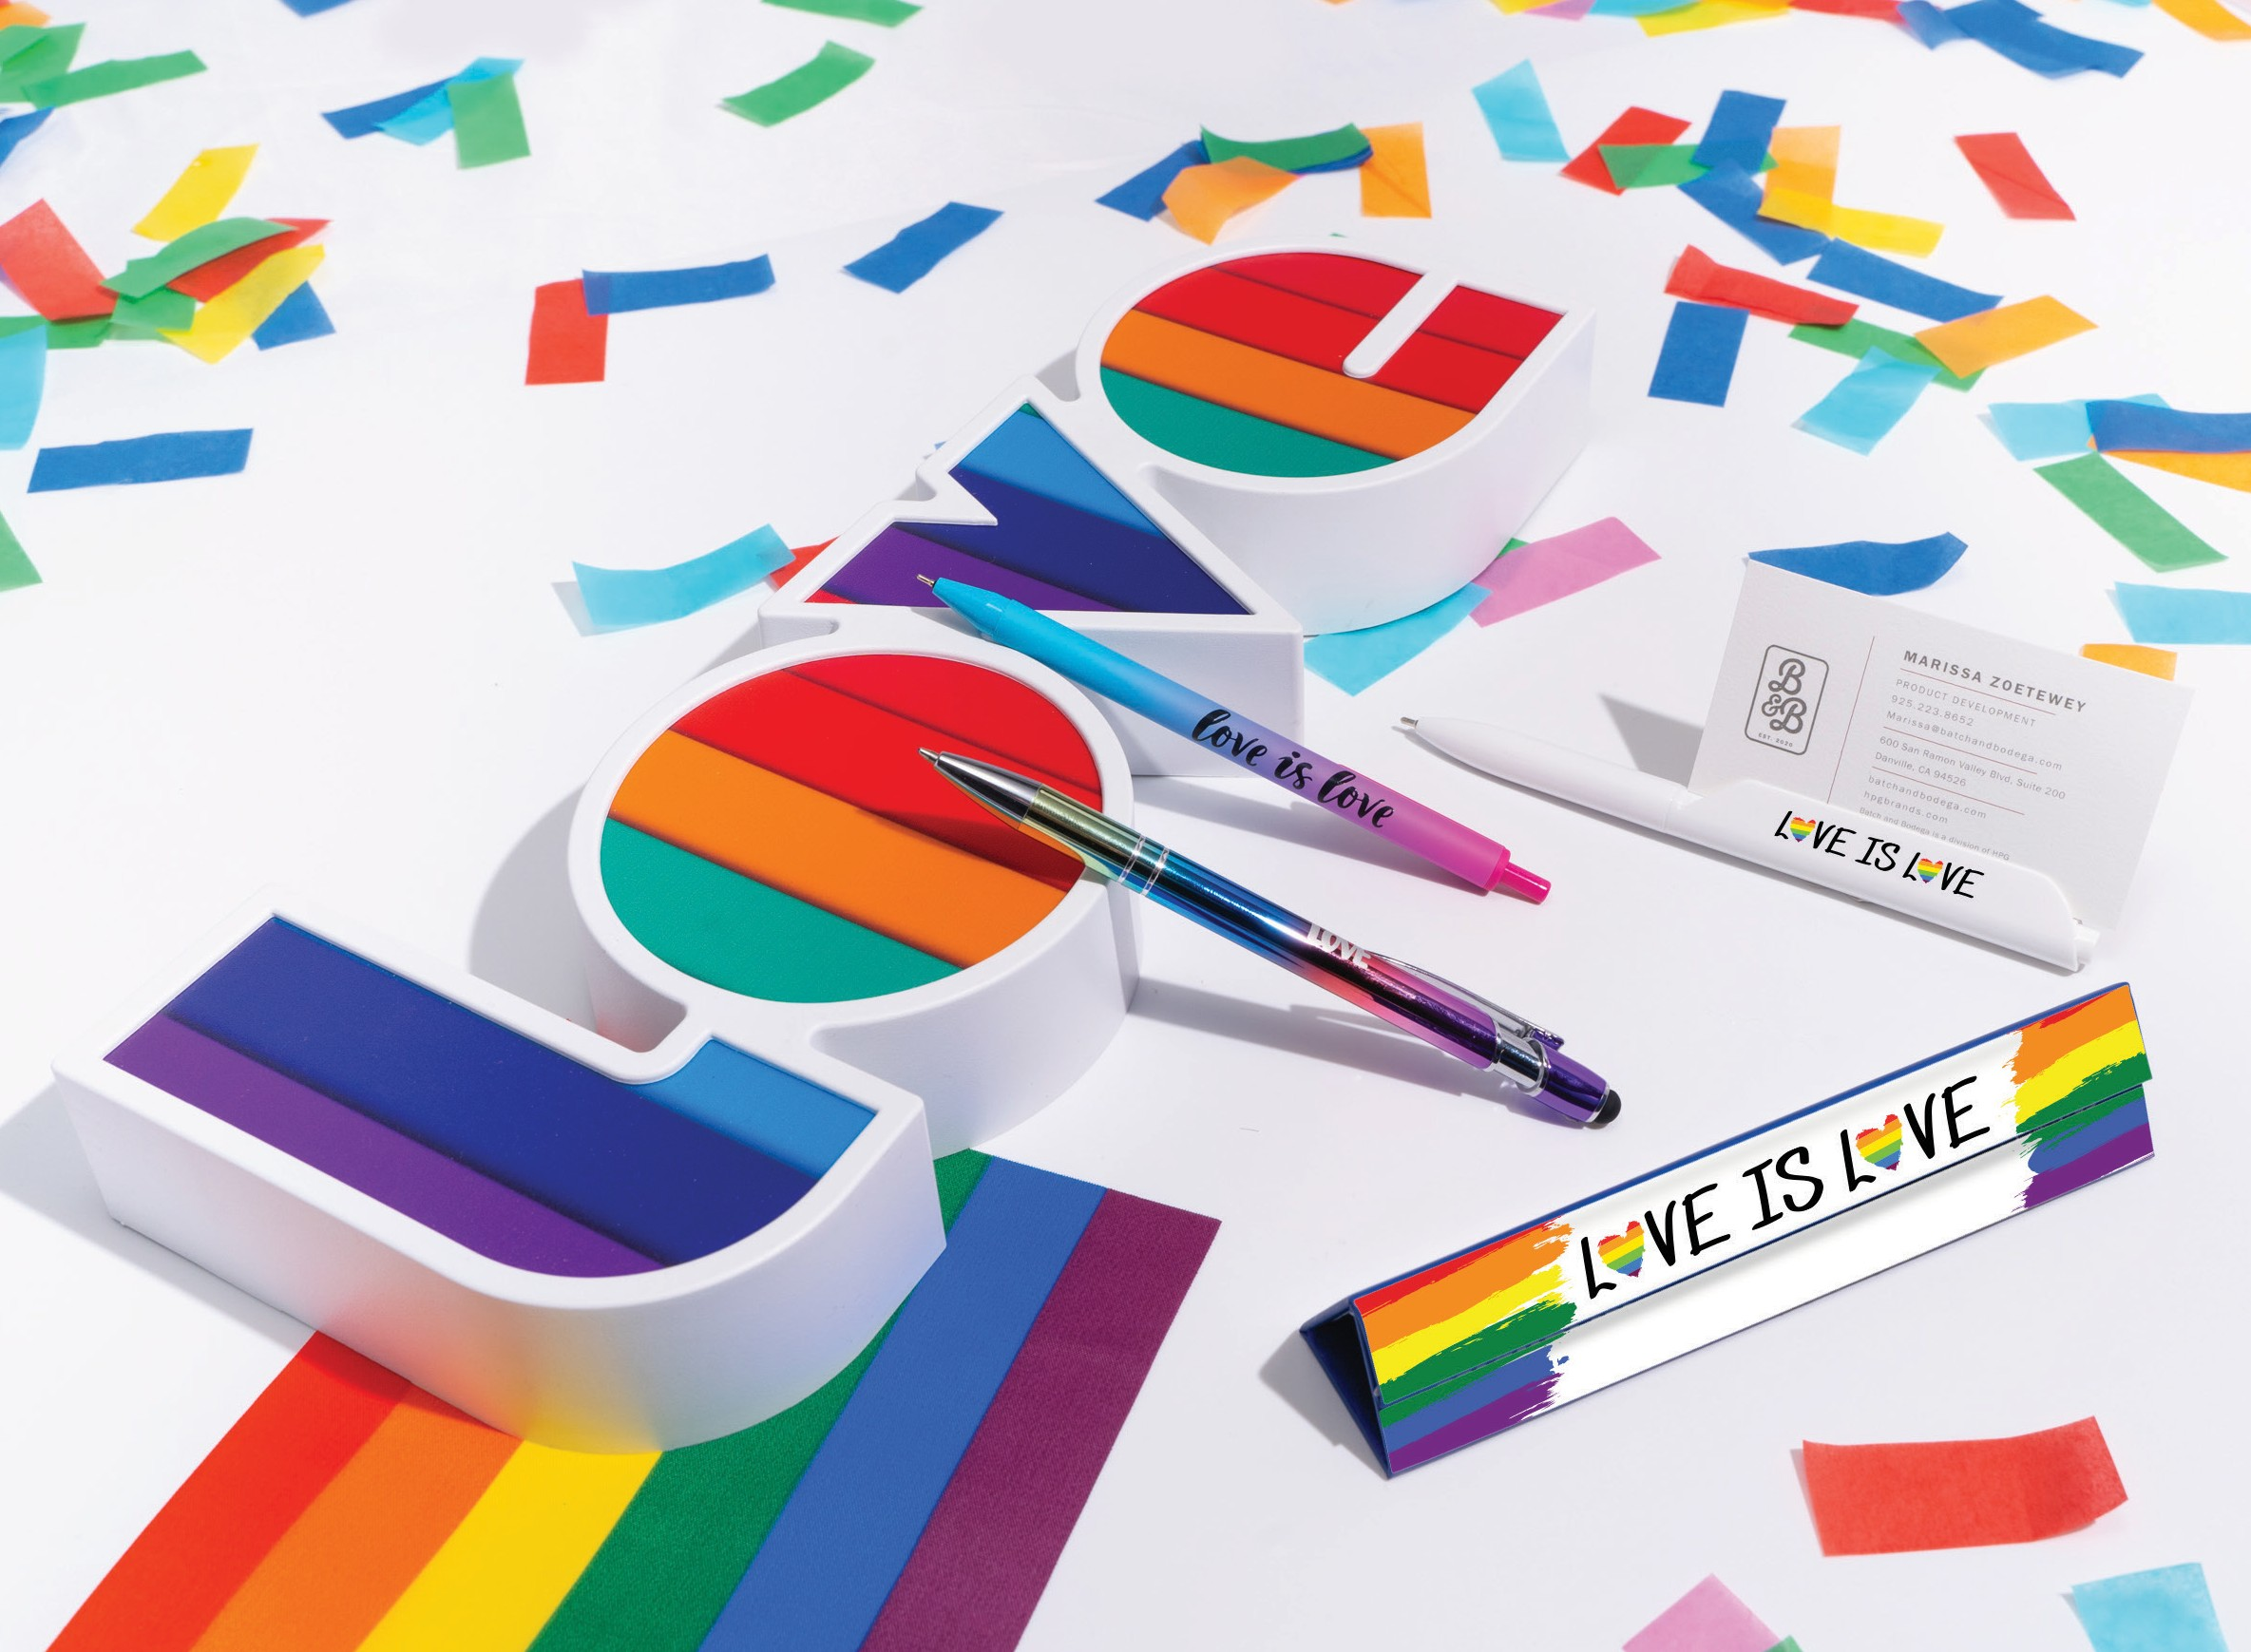
C
B
A
D
COLORFUL PENS TO CELEBRATE!
Share the love with these colorful products!
A. Textari® Spectrum
Item: 701
C. Graffeto
Item: 502
B. Lemonade Comfort
Item: 263
D. Prism Gift Box
Item: PRISMBOX
Good through 12/31/2021. 1 Color silkscreen setup $15. Standard full color imprint setup $45. Laser logo setup $45, FREE straight line imprint. FREE 24 hour rush service available, restrictions apply. Standard production is five business days. FOB MA. All pricing in USD and subject to change.
Complete product information available online.

