Slide 1
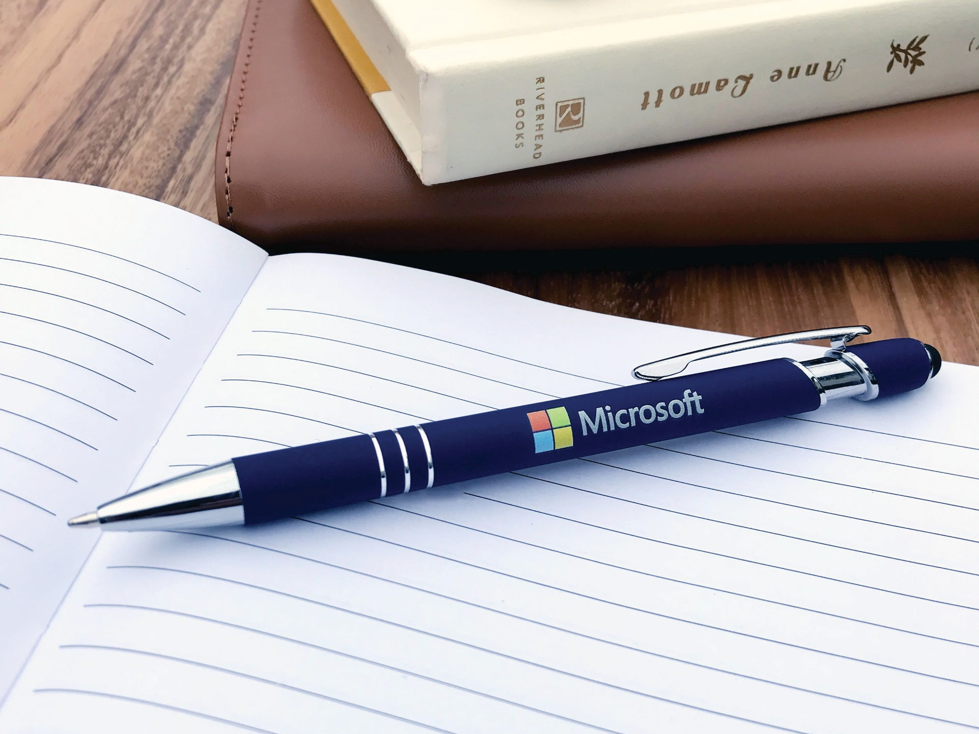
Textari® Comfort Stylus
(Item No: 693)
2-in-1 Executive metal pen with stylus for touchscreen devices
Rubberized matte finish for added comfort
Smooth writing ink
Good through 12/31/2021. Standard laser logo setup $45, FREE straight line imprint. Optional full color imprint available, additional charges and restrictions apply. Standard production is five business days. FOB MA. All pricing in USD and subject to change. Complete product information available.

