Slide 1
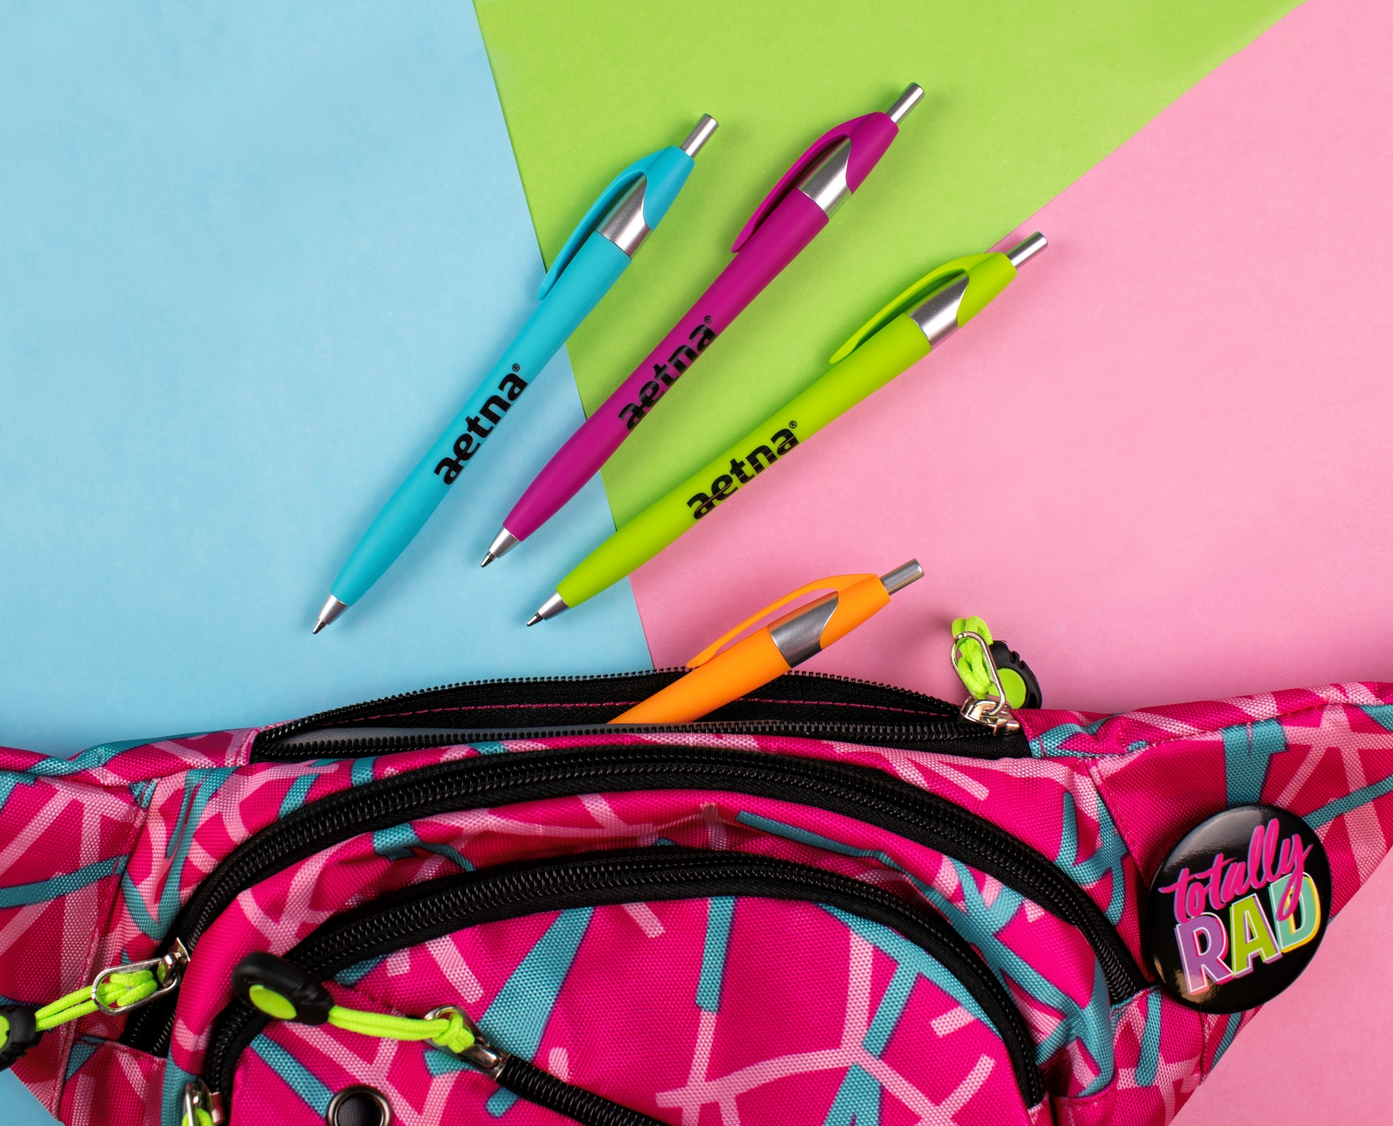
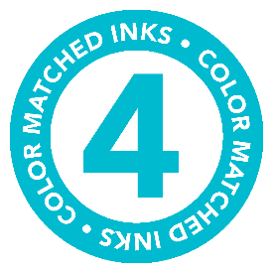
Javalina® Comfort Write
Item No: 315
Enjoy writing in color with this soft touch plastic pen
Neon brights and an ergonomic barrel with silver trim
Guaranteed ultra smooth color matched writing ink
ASI 61966 SAGE 50033 UPIC HUBPEN PPAI 110772 | 781.535.5500 | hubpen.com
Good through 12/31/2020. 1 Color silkscreen setup $15 (G). FREE 24 Hour Rush Service available, restrictions apply. Optional full color imprints available, additional charges and restrictions apply. Standard production is five business days. FOB MA. All pricing in USD and subject to change. Complete product information available.

