Slide 1
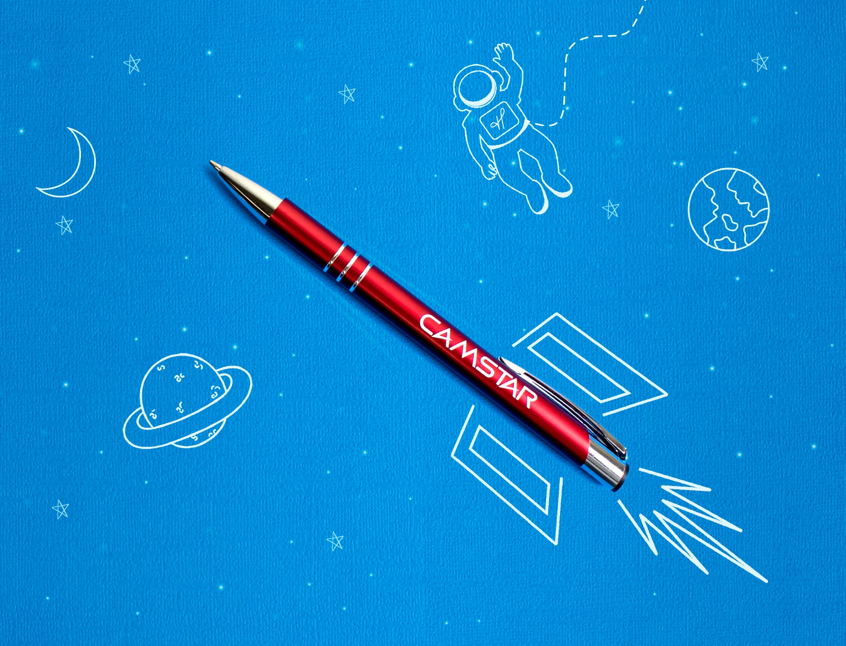
24 Hour Rush Service
Choose from select metal pen styles.
Our high quality metal pens are perfect for reaching your target audience.
Sonata®
• FREE 24 hour service available
• Great marketing tool
• Premier quality design & construction
Classic metal pen with push retraction
Shimmering fashion colors
Shining silver accents and engraving
Smooth black writing ink
MORE STYLES AVAILABLE
ASI 61966 SAGE 50033 UPIC HUBPEN PPAI 110772 | 781.535.5500 | hubpen.com
Good through 12/31/2020. FREE 24 hour rush service available, restrictions apply. Laser logo setup $45 (G), FREE straight line imprint. Standard production is five business days. FOB MA. All pricing in USD and subject to change. Complete product information available.

