Slide 1
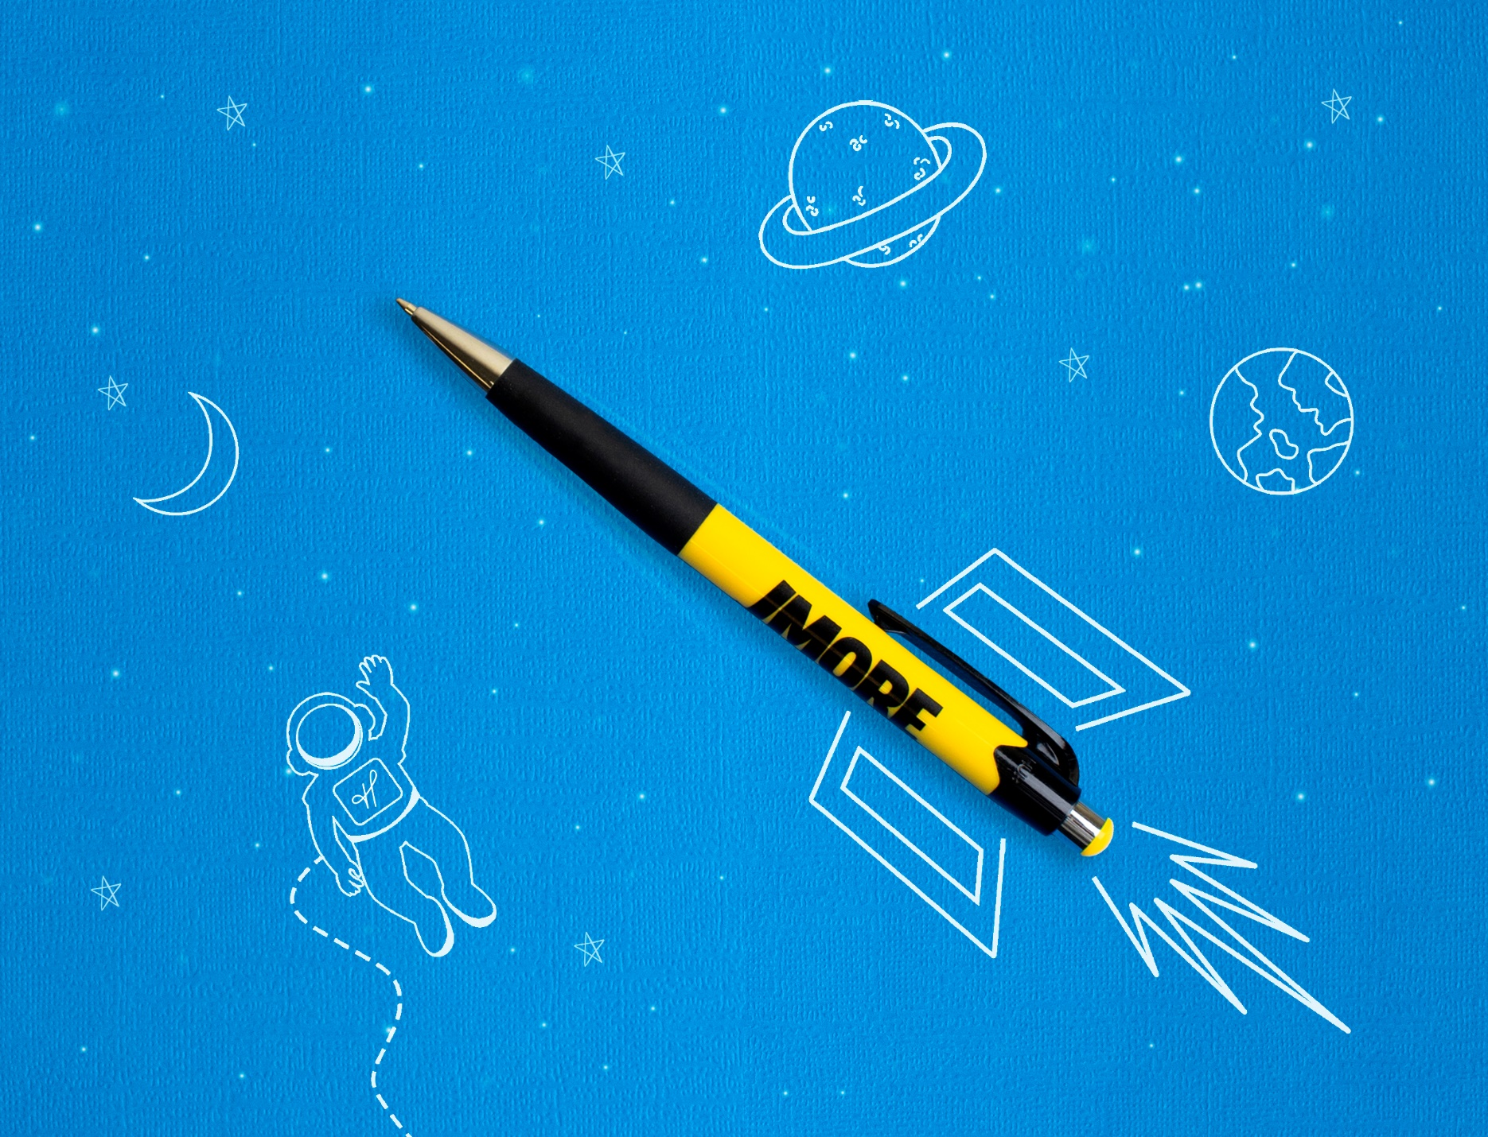
24 Hour Rush Service
Choose from hundreds of plastic pen styles.
We have a vast variety of colors and styles to fit every budget.
Mardi Gras®
• FREE 24 hour service available
• Great marketing tool
• Premier quality design & construction
A plastic pen with a push action retraction
Jumbo barrel with black rubber grip
Guaranteed ultra smooth blue (default) or black writing ink
MORE STYLES AVAILABLE
Good through 12/31/2020. FREE 24 hour rush service available, restrictions apply. 1 Color silkscreen only. Setup charge $15. Standard production is five business days. FOB MA. All pricing in USD and subject to change. Complete product information available.

