Slide 1
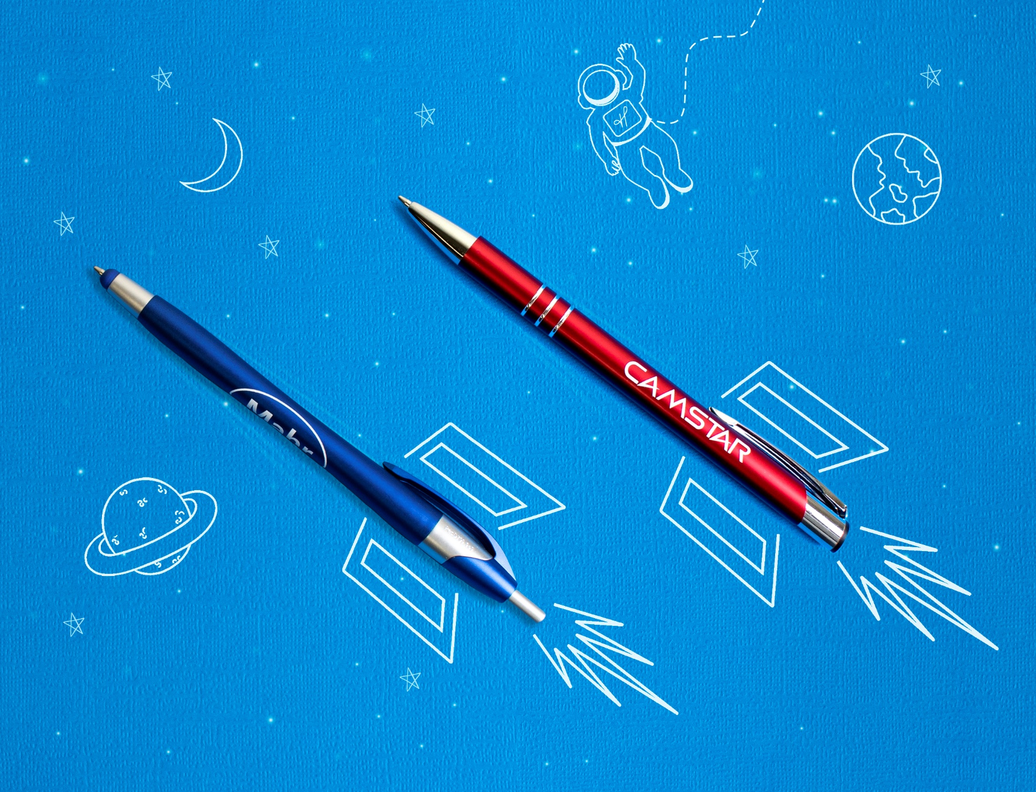
24 Hour Rush Service
A
B
Choose from select plastic and metal pen styles.
Our pens are perfect for perfect for reaching your target audience.
• FREE 24 hour service available
• Great marketing tool
• Premier quality design & construction
A. 331 Javalina® Metallic Stylus
Pat. D709,949
B. 687 Sonata®
MORE STYLES AVAILABLE
Good through 12/31/2020. FREE 24 hour rush service available, select styles only, restrictions apply. Plastic: 1 color silkscreen only, setup charge $15. Metal: Laser logo setup $45, FREE straight line imprint. Standard production is five business days. FOB MA. All pricing in USD and subject to change. Complete product information available.

