Slide 1
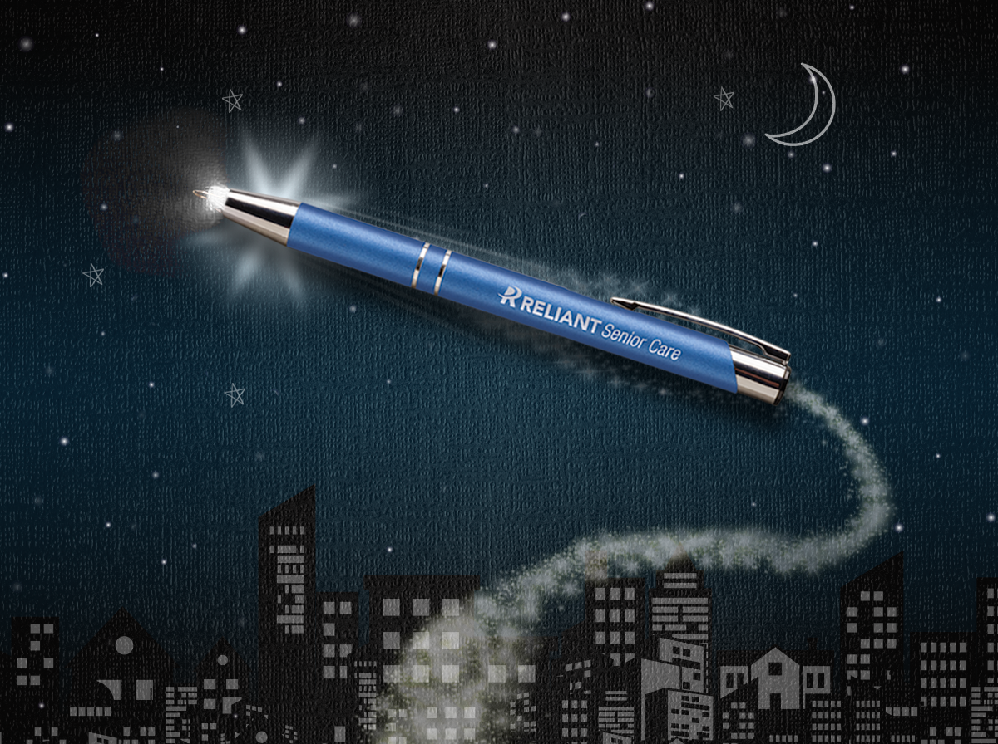
A
B
C
24 Hour Rush Service
Choose from select metal pen styles.
Our high quality metal pens are perfect for reaching your target audience.
• FREE 24 hour service available
• Great marketing tool
• Premier quality design & construction
A. 690 Sonata® Torch
B. 628 Vienna®
C. 699 Textari® Stylus
MORE STYLES AVAILABLE
Good through 12/31/2020. FREE 24 hour rush service available on select pens only, restrictions apply: 500 max. qty., no proofs special packaging, no personalization or rotation engraving. Standard engraving: Laser logo setup $45, FREE straight line imprint. Standard production is five business days. FOB MA. All pricing in USD and subject to change. Complete product information available.

