Slide 1
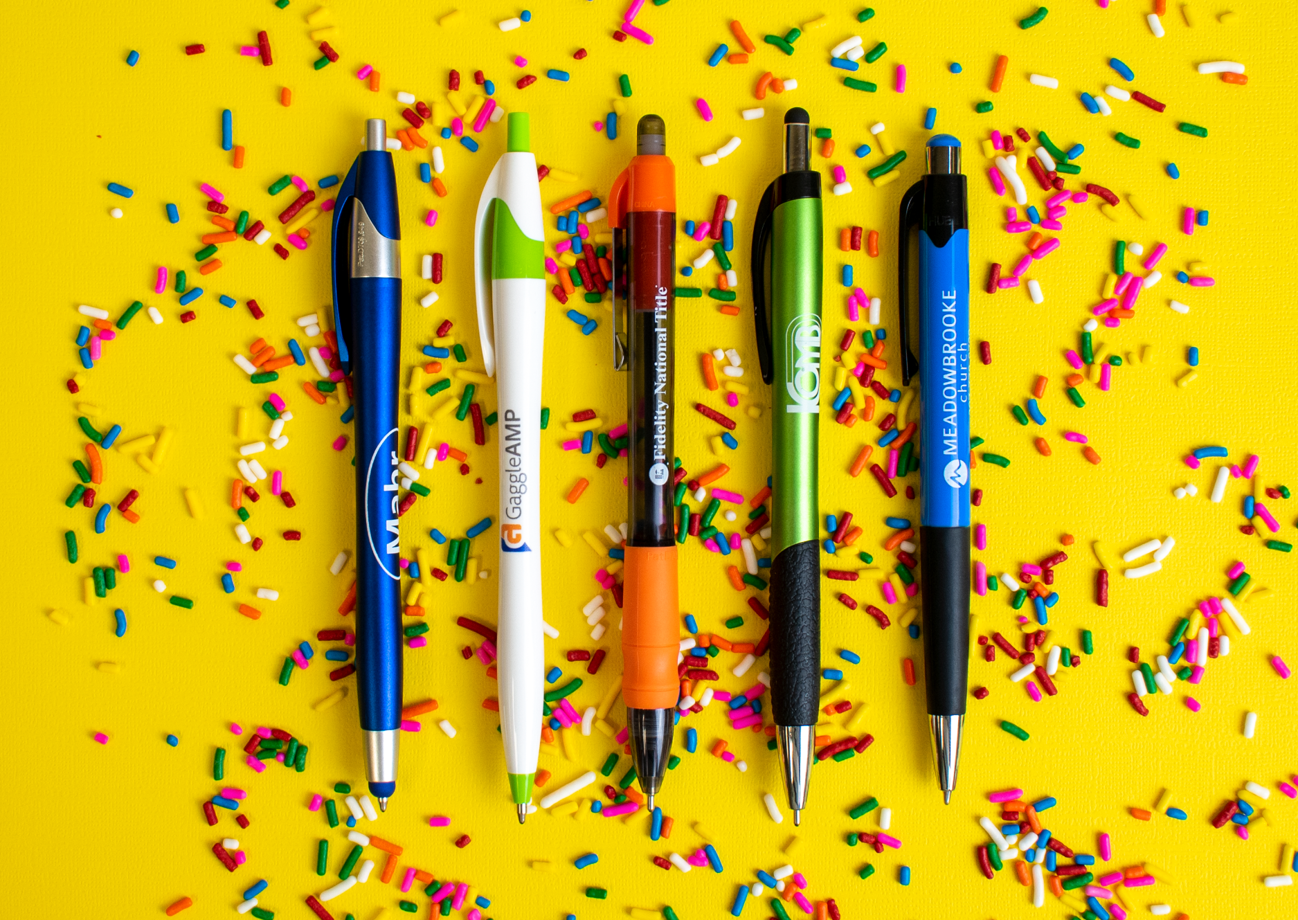
Top 5 Plastic Pens
A
B
C
D
E
We know and love them, we think you will too.
A. 331 Javalina® Metallic Stylus
D. 384 Mateo® Stylus
B. 326 Javalina Splash®
2 Color
E. 411 Mardi Gras®
Full Color
2 Color
C. 588 MaxGlide Click® Tropical
Full Color
2 Color
ASI 61966 SAGE 50033 UPIC HUBPEN PPAI 110772 | 781.535.5500 | hubpen.com
Good through 12/31/19. Setup charge $15 (G), FREE 24 Hour Rush Service available. 2 color and full color: Available on select styles only, additional charges apply. Standard production is five business days. FOB MA. All pricing in USD and subject to change. Complete product information available.

