Slide 1
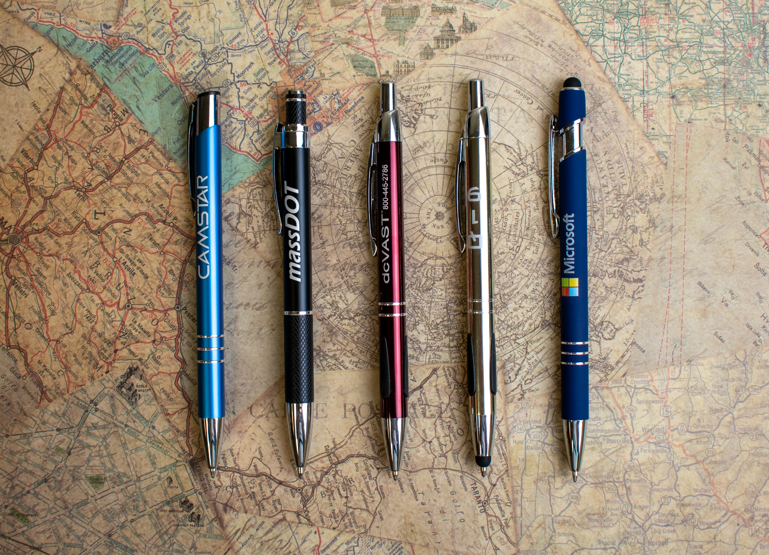
Top 5 Metal Pens
A
B
C
D
E
We know and love them, we think you will too.
A.687 Sonata®
D. 636 Vienna® Stylus
B. 683 Aruba™
E. 693 Textari® Comfort Stylus
Full Color White Only
Full Color
C. 628 Vienna®
ASI 61966 SAGE 50033 UPIC HUBPEN PPAI 110772 | 781.535.5500 | hubpen.com
Good through 12/31/19. Laser logo setup $45 (G), FREE straight line imprint. FREE 24 Hour Rush Service available on select metal pens, conditions apply. Full color: Available on select styles, additional charges apply. Standard production is five business days. FOB MA.
All pricing in USD and subject to change. Complete product information available.

