Slide 1
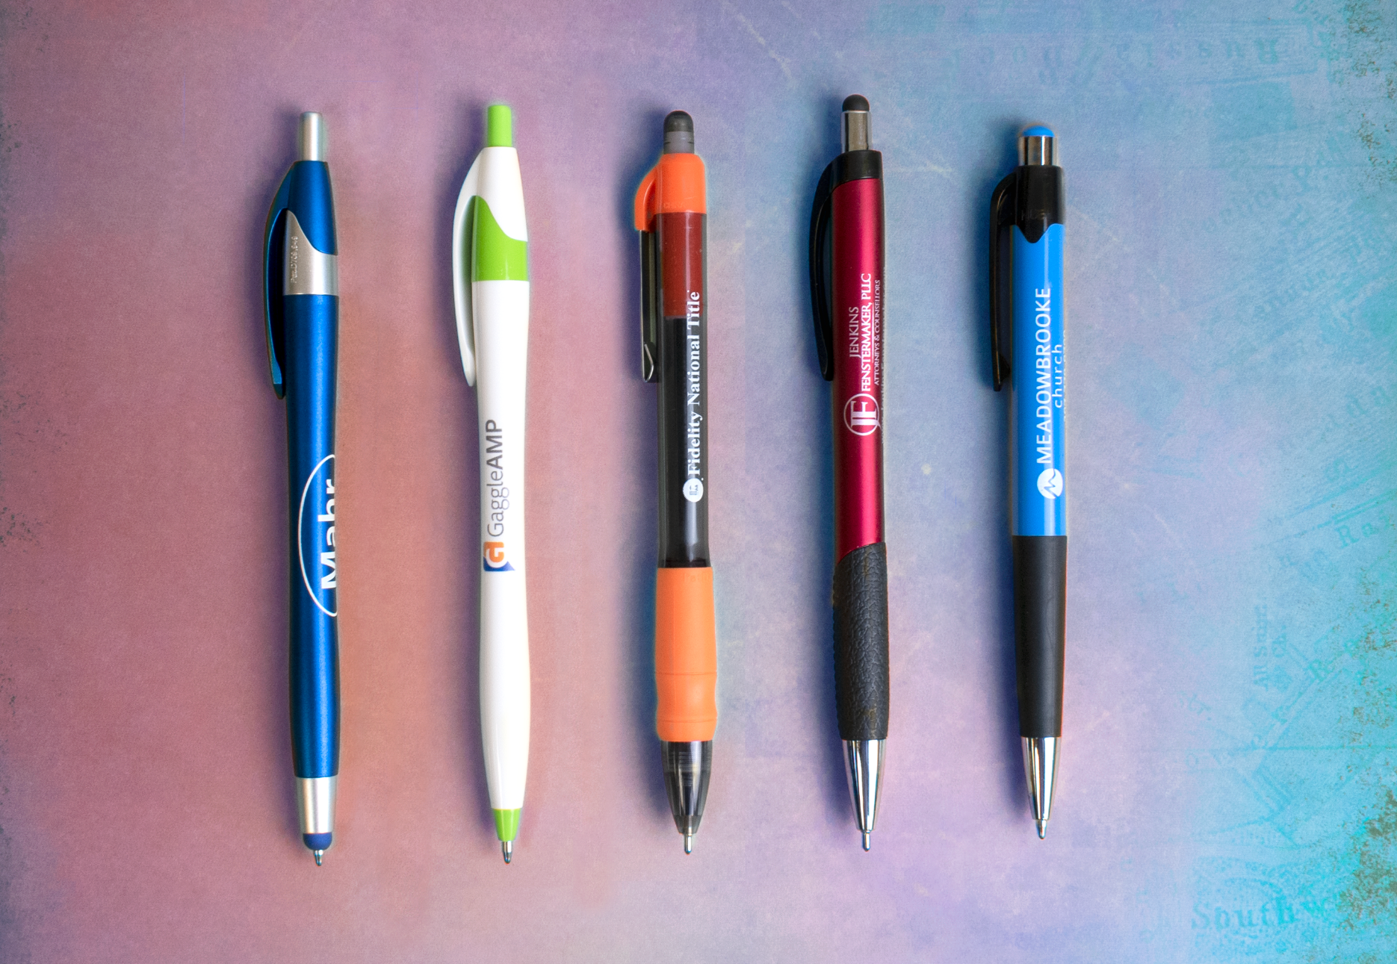
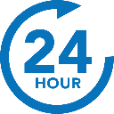
A
B
C
D
E
Top 10 Pens
Plastic Pens
We know and love them, we think you will too.
A. 331 Javalina® Metallic Stylus
D. 384 Mateo® Stylus
B. 326 Javalina Splash®
2 Color
E. 411 Mardi Gras®
Full Color
2 Color
C. 588 MaxGlide Click® Tropical
Full Color
2 Color
Continues on next page >
ASI 61966 SAGE 50033 UPIC HUBPEN PPAI 110772 | 781.535.5500 | hubpen.com
Good through 12/31/19. Setup charge $15 (G), FREE 24 Hour Rush Service available. 2 color and full color: Available on select styles only, additional charges apply. Standard production is five business days. FOB MA. All pricing in USD and subject to change. Complete product information available.

Slide 2
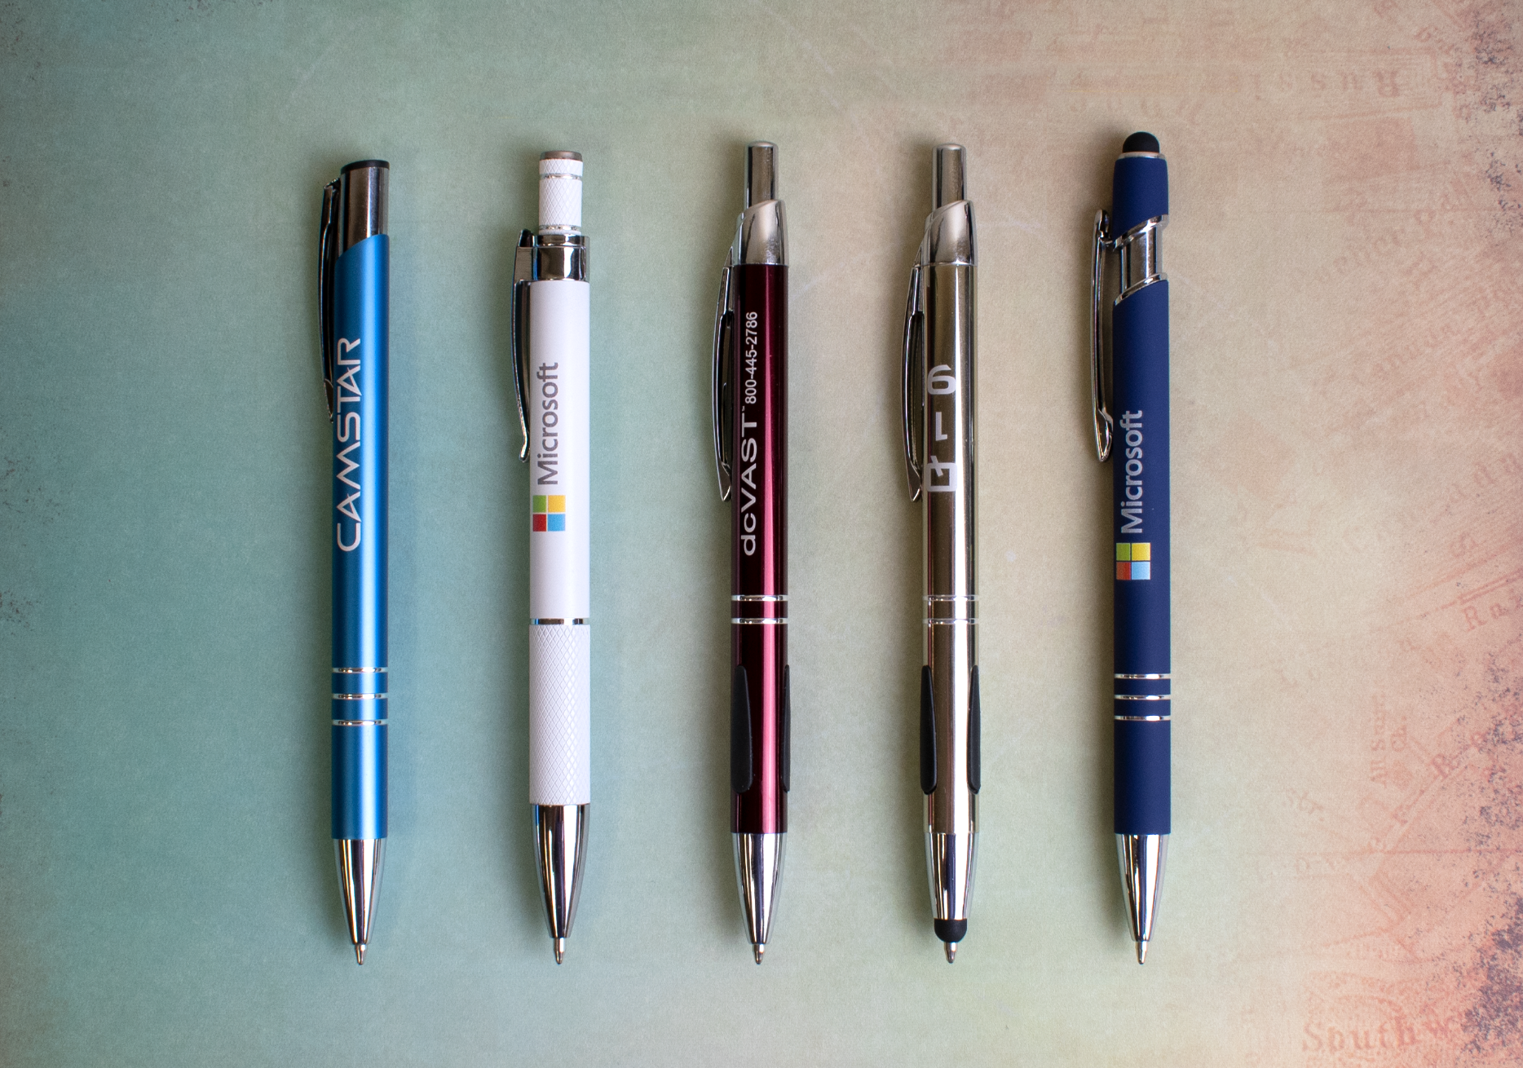
F
G
H
I
J
Top 10 Pens
Metal Pens
We know and love them, we think you will too.
F.687 Sonata®
I. 636 Vienna® Stylus
G. 683 Aruba™
J. 693 Textari® Comfort Stylus
Full Color White Only
Full Color
H. 628 Vienna®
ASI 61966 SAGE 50033 UPIC HUBPEN PPAI 110772 | 781.535.5500 | hubpen.com
Good through 12/31/19. Laser logo setup $45 (G), FREE straight line imprint. Full color: Available on select styles, additional charges apply. Standard production is five business days. FOB MA. All pricing in USD and subject to change. Complete product information available.

