Slide 1
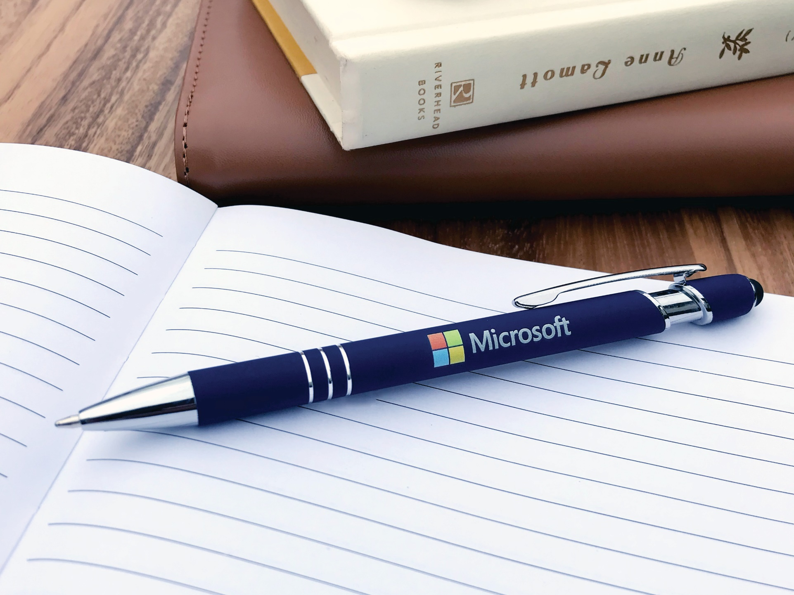
Textari® Comfort Stylus
2-in-1 Executive metal pen with stylus
Rubberized matte finish for added comfort
Smooth writing ink
Full Color
ASI 61966 SAGE 50033 UPIC HUBPEN PPAI 110772 | 781.535.5500 | hubpen.com
Good through 12/31/19. Metal: Laser logo setup $45 (G), FREE straight line imprint. Full Color: Available, additional charges apply. Standard production is five business days. FOB MA. All pricing in USD and subject to change. Complete product information available.

